Slide 1
Selection or Socialization? A Propensity Score Matched Study of Personality and Life Events
Emorie D Beck
Washington University in St. Louis
Preregistration: https://osf.io/vdazq/ Web App: emoriebeck.shinyapps.io/life_events

Slide 2
The Big 5
Extraversion
Agreeableness
Conscientiousness
Neuroticism
Openness
Direction
Magnitude
--
.6 SD
1 SD
-.8 SD
.4 SD
Timing
--
Lifespan
Lifespan
10-35
10-20
Roberts, Walton, & Viechtbauer, 2006
Notes:
Personality traits are stable but they also show change
That change varies in
direction, with …
magnitude, with …
and time, with …

Slide 3
Selection
Socialization
Conscientiousness
Conscientiousness
Work Experiences
Work Experiences
Barrick, Mount, & Judge, 2001
Roberts, Caspi, & Moffitt, 2003
Notes:
There has been effort to understand what leads to personality change, or what so-called socialization effects might lead to changes, with for example, work experiences being associated with changes in Conscientiousness in young adulthood
But there is also evidence that personality predicts life experiences. People select into experiences based on their personalities, with conscientiousness, for example, predicting work experiences.
Raises the question of the relationship between selection and socialization.

Slide 4
Selection
Extraversion
Agreeableness
Conscientiousness
Neuroticism
Openness
Move in with Partner (+)
(Specht et al., 2011)
Become Unemployed (+)
(Specht et al., 2011)
Mortality (-)
(Specht et al., 2011)
Mortality (+)
(Specht et al., 2011)
First Job (-)
(Lüdtke et al., 2011)
Have Children (+)
(van Scheppingen et al, 2016)
Separate from Partner (-)
(van Scheppingen et al, 2016)
Health (+)
(van Scheppingen et al, 2016)
Health (-)
(van Scheppingen et al, 2016)
End Relationship (+)
(Lüdtke et al., 2011)
Romantic Relationships (+)
(Wagner et al., 2015)
Do Military Service (-)
Jackson et al., 2012)
Work Experiences (+)
(Lüdtke et al., 2011)
Leave Parents’ Home (+)
(Lüdtke et al., 2011)
Retirement (+)
(Specht et al., 2011)
Notes:
To understand this, let’s look at past research on socialization and selection

Slide 5
Selection
Limitations
Cross-Sectional Design
(Reverse Causality)
Inattention to Third Variables
(Selection Bias)
Notes:
Despite seemingly resounding evidence for personality’s ability to predict experiences, there are two key limitations to previous work on the topic

Slide 6
Selection
Limitations
Personality
Cross-Sectional Design
(Reverse Causality)
T1
T2
Life Events
Notes:
Much of the work linking personality to experiences does so cross sectionally, looking at how concurrent measures of personality predict life events experienced up that point (e.g. are you married)

Slide 7
Selection
Limitations
Personality
Cross-Sectional Design
(Reverse Causality)
T1
T2
Life Events
Notes:
But a “true” selection effect is prospective

Slide 8
Selection
Limitations
Personality
Inattention to Third Variables (Selection Bias)
Income
Social
Age
Early Life
Health
T1
T2
Education
Family
Life Events
Notes:
Second, although many study will control for “standard” demographic characteristics like age and gender, there is inattention to the other factors that might influence personality and explain its prediction of life events

Slide 9
Socialization
Extraversion
Agreeableness
Conscientiousness
Neuroticism
Openness
Marriage / Move in with Partner (-)
(Specht et al., 2011)
Changing Majors (+)
(Lüdtke et al., 2011)
Retirement (-)
(Specht et al., 2011)
Psychotherapy (-)
(Lüdtke et al., 2011;
Roberts et al., 2017)
Retirement (+)
(Schwaba & Bleidorn, 2017)
Leave Parents’ Home (-)
(Specht et al., 2011)
Separate from Partner (+)
(Specht et al., 2011)
Child Birth (-)
(Specht et al, 2011)
First Job (+)
(Lüdtke et al., 2011)
Child Birth (+)
(van Scheppingen et al, 2016)
Romantic Relationships (+)
(Neyer & Lehnart, 2007)
Military Service (-)
(Jackson et al., 2012)
First Job (+)
(George, Helson, & John, 2011; Lüdtke et al., 2011; Specht et al., 2011)
Romantic Relationships (-)
(Neyer & Lehnart, 2007)
Marriage (-)
(Specht et al., 2011)
Notes:
make iterative
extraverion + romantic relationshiop

Slide 10
Socialization
Limitations
Inconsistent Results
Inattention to Third Variables
(Selection Bias)
Notes:
Research on socialization effects is relatively young compared to selection effects. It too has key limitations

Slide 11
Socialization
Limitations
Extraversion
Agreeableness
Conscientiousness
Neuroticism
Openness
Marriage / Move in with Partner (-)
(Specht et al., 2011)
Changing Majors (+)
(Lüdtke et al., 2011)
Retirement (-)
(Specht et al., 2011)
Psychotherapy (-)
(Lüdtke et al., 2011;
Roberts et al., 2017)
Retirement (+)
(Schwaba & Bleidorn, 2017)
Leave Parents’ Home (-)
(Specht et al., 2011)
Separate from Partner (+)
(Specht et al., 2011)
Child Birth (-)
(Specht et al, 2011)
First Job (+)
(Lüdtke et al., 2011)
Child Birth (+)
(van Scheppingen et al, 2016)
Romantic Relationships (+)
(Neyer & Lehnart, 2007)
Military Service (-)
(Jackson et al., 2012)
First Job (+)
(George, Helson, & John, 2011; Lüdtke et al., 2011; Specht et al., 2011)
Romantic Relationships (-)
(Neyer & Lehnart, 2007)
Marriage (-)
(Specht et al., 2011)
Notes:
First, many of the already limited results are inconsistent with one another.
Here, you see that more than half of the socialization effects I presented earlier have either not been found in other studies examining the same events or have found effects in the opposite direction.

Slide 12
Socialization
Limitations
Extraversion
Agreeableness
Conscientiousness
Neuroticism
Openness
Marriage / Move in with Partner (-)
(Specht et al., 2011)
Changing Majors (+)
(Lüdtke et al., 2011)
Retirement (-)
(Specht et al., 2011)
Psychotherapy (-)
(Lüdtke et al., 2011;
Roberts et al., 2017)
Retirement (+)
(Schwaba & Bleidorn, 2017)
Leave Parents’ Home (-)
(Specht et al., 2011)
Separate from Partner (+)
(Specht et al., 2011)
Child Birth (-)
(Specht et al, 2011)
First Job (+)
(Lüdtke et al., 2011)
Child Birth (+; Men only)
(van Scheppingen et al, 2016)
Romantic Relationships (+)
(Neyer & Lehnart, 2007)
Military Service (-)
(Jackson et al., 2012)
First Job (+)
(George, Helson, & John, 2011; Lüdtke et al., 2011; Specht et al., 2011)
Romantic Relationships (-)
(Neyer & Lehnart, 2007)
Marriage (-)
(Specht et al., 2011)
Notes:
First, many of the already limited results are inconsistent with one another.
Here, you see that more than half of the socialization effects I presented earlier have either not been found in other studies examining the same events or have found effects in the opposite direction.

Slide 13
Socialization
Limitations
Selection Bias
Jackson et al., 2012; van Scheppingen et al., 2016;
Wagner et al., 2015
Notes:
One reason for inconsistent results might be what I just spent several minutes discussing – personality predicts the very events that are thought to influence personality. Thus, observed differences in patterns of change might be due to characteristics of a person rather than the event itself. In other words, personality might define their responses to those events in ways that shape personality.

Slide 14
Conscientiousness
First Job
Conscientiousness
Persistence at difficult tasks
Event
Conscientiousness
Work Experiences
Lüdtke et al., 2011; Specht et al., 2011; Jackson et al., 2010
Notes:
Consider Conscientiousness, for example. Conscientiousness predicts starting first jobs. However, in addition, Conscientiousness also predicts behavior after starting a job. People higher in Conscientiousness tend to be more successful and to receive more promotions, which may make them more likely to be given more responsibilities that require them to be more Conscientious. Thus, these changes aren’t independent.
These achievements are likely to come with substantial challenges, which Conscientious people, who are willing to work longer hours and persist in the face of failure (Jackson et al., 2010), are ready to meet, which may make them more Conscientious and lead to further advancement. The relationship between personality and life events is cyclical, which highlights a key issue in the examination of personality change. If people select into life events that also appear to change them, how do we tease apart change that may be due existing personality differences that bring about an event (selection) from change that is due purely to the event (socialization)?

Slide 15
Socialization
Limitations
Selection Bias
Jackson et al., 2012; van Scheppingen et al., 2016;
Wagner et al., 2015
Notes:
Thus, these baseline differences might drive socialization effects.
But what happens if we eliminate selection effects and examine “pure” socialization effects?

Slide 16
Socialization
Limitations
Selection Bias
Normative Development
Arrested Development
Bollich, Beck, Hill, & Jackson, 2018
Retrogression
Accelerated Maturation
Notes:
Normative development: transition to parenthood and military training, showing minimal changes across the big 5
Arrested development: military training
Retrogression: conscientiousness and first job and divorce: divorced people or people who started first job increased while everyone else decreased
Accelerated maturation: countries with citizens who have work and family experiences early show patterns of early life normative development earlier than other countries

Slide 17
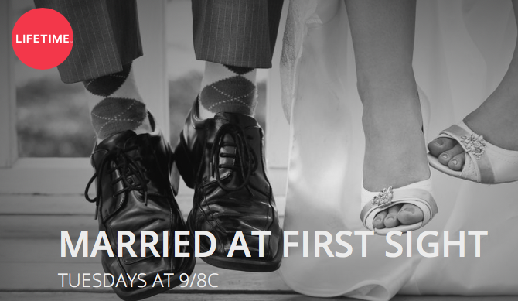
Notes:
But how do we eliminate selection bias? Well, typically, we’d use random assignment to assign people to so-called treatment and control conditions. But we can’t do that with life events. Awhile back, I tried to do that with marriage and the IRB wouldn’t let me. Turns out I should have copyrighted the idea because apparently this is ethical on network television.

Slide 18

No Event
Event
Propensity Score Matching
(Thoemmes & Kim, 2011)
Notes:
But I didn’t, so I’m stuck looking for an alternative solution.
Technique called propensity score matching. Essentially take a bunch of predictors and use them to predict an outcome. Then use these predictions (so-called propensity scores for each person) and start matching people with the same propensities who did and didn’t experience events.

Slide 19
No Event
Event
PS = .2
(Thoemmes & Kim, 2011)

Slide 20
No Event
Event
PS = .2
PS = .6
(Thoemmes & Kim, 2011)

Slide 21
No Event
Event
PS = .2
PS = .6
PS = .9
(Thoemmes & Kim, 2011)

Slide 22
No Event
Event
PS = .2
PS = .6
PS = .9
PS = .3
(Thoemmes & Kim, 2011)

Slide 23
No Event
Event
PS = 1.2
PS = .6
PS = .9
PS = .4
PS = .3
PS = .7
PS = .6
PS = 1.0
PS = .1
PS = .9
(Thoemmes & Kim, 2011)
Notes:
Note that not everyone may have a match. Propensity scores don’t tend to be equal across groups. People who can’t be matched are left out.

Slide 24
Propensity Score Matching
Selection
Socialization
E
A
C
N
O
E
A
C
N
O
Life Events
Life Events

Slide 25
German Socioeconomic Panel Study (GSOEP)
1984
2005
2009
2013
Matching Variables
demographics (e.g. sex)
activities (e.g. volunteering)
financial (e.g. gross wages)
household (e.g. number of household members)
health (e.g. BMI)
psychological (e.g. life satisfaction),
relationship (e.g. relationship with father)
social (e.g. visits to friends)
Preregistration: https://osf.io/vdazq/
Notes:
In this study, we used matching variables that fell in to 8 categories to match people who did or didn’t experience 12 life events. Matching varibales were collected between 1984 and 2005.
2005-2013: personality measured at 3 waves
2006-2015: life events measured each wave
People coded as 1 if they experience the event in that 10 year period, and 0 otherwise

Slide 26
Matching Variables
Category | Item | Item Text
Procedural | PROC_SID | Never Changing Person ID
 | PROC_household | household ID
Demographics | Dem_DOB | Year of Birth
 | Dem_Sex | Sex
Activities | Act_Volunteer | perform volunteer work
Background | Bkgr_DadPres | Father Present
 | Bkgr_DisabStat | Disability Status of Individual
 | Bkgr_Edu | Type of tertiary degree
 | Bkgr_MarStat | Marital Status of individual
 | Bkgr_MomPres | Mother Present
 | Bkgr_PGovIncome | Pre-Government Income
 | Bkgr_UrbOrRur | Spatial category by BBSR
Demographics | Dem_Race | Race of individual
Financial | Fnc_GrossSlry | Gross Amount Of Wages, Salary Prev. Yr
 | Fnc_HouseAssist | Housing Assistance
 | Fnc_StudGrnt | Student Grant
 | Fnc_UnempBen | unemployment benefit
Household | HH_BrothPres | Brother Present
 | HH_ClnHlp | Cleaning Or Household Help In Household
 | HH_CndHouse | Condition Of House
 | HH_ColTV | Household Has Color Television
 | HH_NumPer | Number Of Persons In Household
 | HH_NumPer15to18 | Number of hh members age 15-18
 | HH_NumPerBel14 | Number of hh members age 0-14
 | HH_SisPres | Sister Present
Health | Hlth_BMI | Body Mass Index
Category | Item | Item Text
Health | Hlth_BodPain | Bodily Pain (NBS)
 | Hlth_EmoRole | Role Emotional (NBS)
 | Hlth_GenHlth | General Health (NBS)
 | Hlth_HeightCM | Body Height in cm
 | Hlth_HlthInsr | Type Of Health Insurance
 | Hlth_MntlHlth | Mental Health (NBS)
 | Hlth_MntlSum | MCS: Summary Scale Mental (NBS)
 | Hlth_NumDrVisits | Number of annual doctor visits
 | Hlth_PhysFunc | Phyiscal Functioning (NBS)
 | Hlth_PhysHlth | PCS: Summary Scale Physical
 | Hlth_PhysProb | Accomplished Less Due To Physical Problems
 | Hlth_PhysRole | Role Physical (NBS)
 | Hlth_SocFunc | Social Functioning (NBS)
 | Hlth_Vitality | Vitality (NBS)
 | Hlth_WeightKG | Weight in kg
Psychological | Psych_LifeSat | Overall Life Satisfaction
 | Psych_OthWorr | Other Worries
 | Psych_SatFam | Satisfaction With Family Life
 | Psych_SatHealth | Satisfaction with Health
 | Psych_SatIncome | Satisfaction With Household Income
 | Psych_SatSchool | Satisfaction With School Education and Vocational Retraining
 | Psych_WorrCrm | Worried About Crime
Relationships | Rel_RelDad | Nature Of Relationship To Father
 | Rel_RelMom | Nature Of Relationship To Mother
Social | Soc_SocGath | Attend Social Gatherings
 | Soc_VisFam | Visit Family Members
 | Soc_VisNghbr | Visit Neighbors, Friends
Notes:
Here are the 53 life events
Give a coupel of examples

Slide 27
German Socioeconomic Panel Study (GSOEP)
Personality
1984
2005
2009
2013
Matching Variables
demographics (e.g. sex)
activities (e.g. volunteering)
financial (e.g. gross wages)
household (e.g. number of household members)
health (e.g. BMI)
psychological (e.g. life satisfaction),
relationship (e.g. relationship with father)
social (e.g. visits to friends)
Preregistration: https://osf.io/vdazq/
Notes:
In this study, we used matching variables that fell in to 8 categories to match people who did or didn’t experience 12 life events. Matching varibales were collected between 1984 and 2005.
2005-2013: personality measured at 3 waves
2006-2015: life events measured each wave
People coded as 1 if they experience the event in that 10 year period, and 0 otherwise

Slide 28
Big 5 Inventory – Short (BFI-S)
E | Am communicative
 | Am sociable
 | Reserved (-)
A | Am sometimes too coarse with others (-)
 | Able to forgive
 | Friendly with others
C | Thorough Worker
 | Tend to be lazy (-)
 | Carry out tasks efficiently
N | Worry a lot
 | Somewhat nervous
 | Deal well with stress (-)
O | Am original
 | Value artistic experiences
 | Have a lively imagination
Notes:
The big 5 were measured using the German translation of the BFI-S

Slide 29
German Socioeconomic Panel Study (GSOEP)
Personality
1984
2005
2009
2013
Matching Variables
demographics (e.g. sex)
activities (e.g. volunteering)
financial (e.g. gross wages)
household (e.g. number of household members)
health (e.g. BMI)
psychological (e.g. life satisfaction),
relationship (e.g. relationship with father)
social (e.g. visits to friends)
Life Events
Preregistration: https://osf.io/vdazq/
Notes:
In this study, we used matching variables that fell in to 8 categories to match people who did or didn’t experience 12 life events. Matching varibales were collected between 1984 and 2005.
2005-2013: personality measured at 3 waves
2006-2015: life events measured each wave
People coded as 1 if they experience the event in that 10 year period, and 0 otherwise

Slide 30
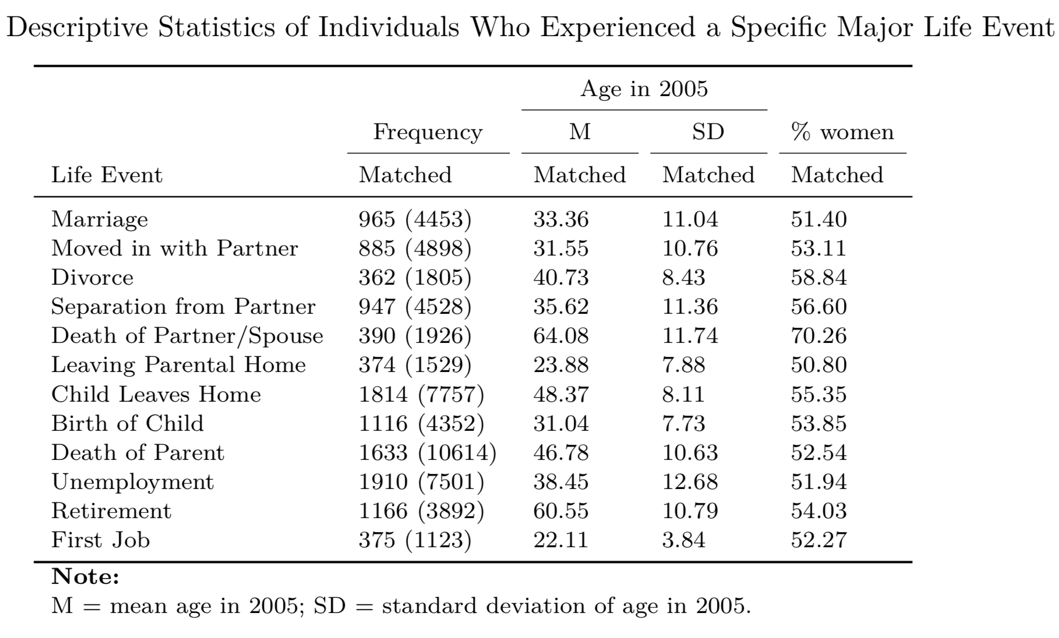
Life Events
Notes:
We measured 12 life events, which you see here. In this table, you’ll also see the distribution of age and gender in matched and unmatched samples as well as the size of the matched and unmatched samples.

Slide 31
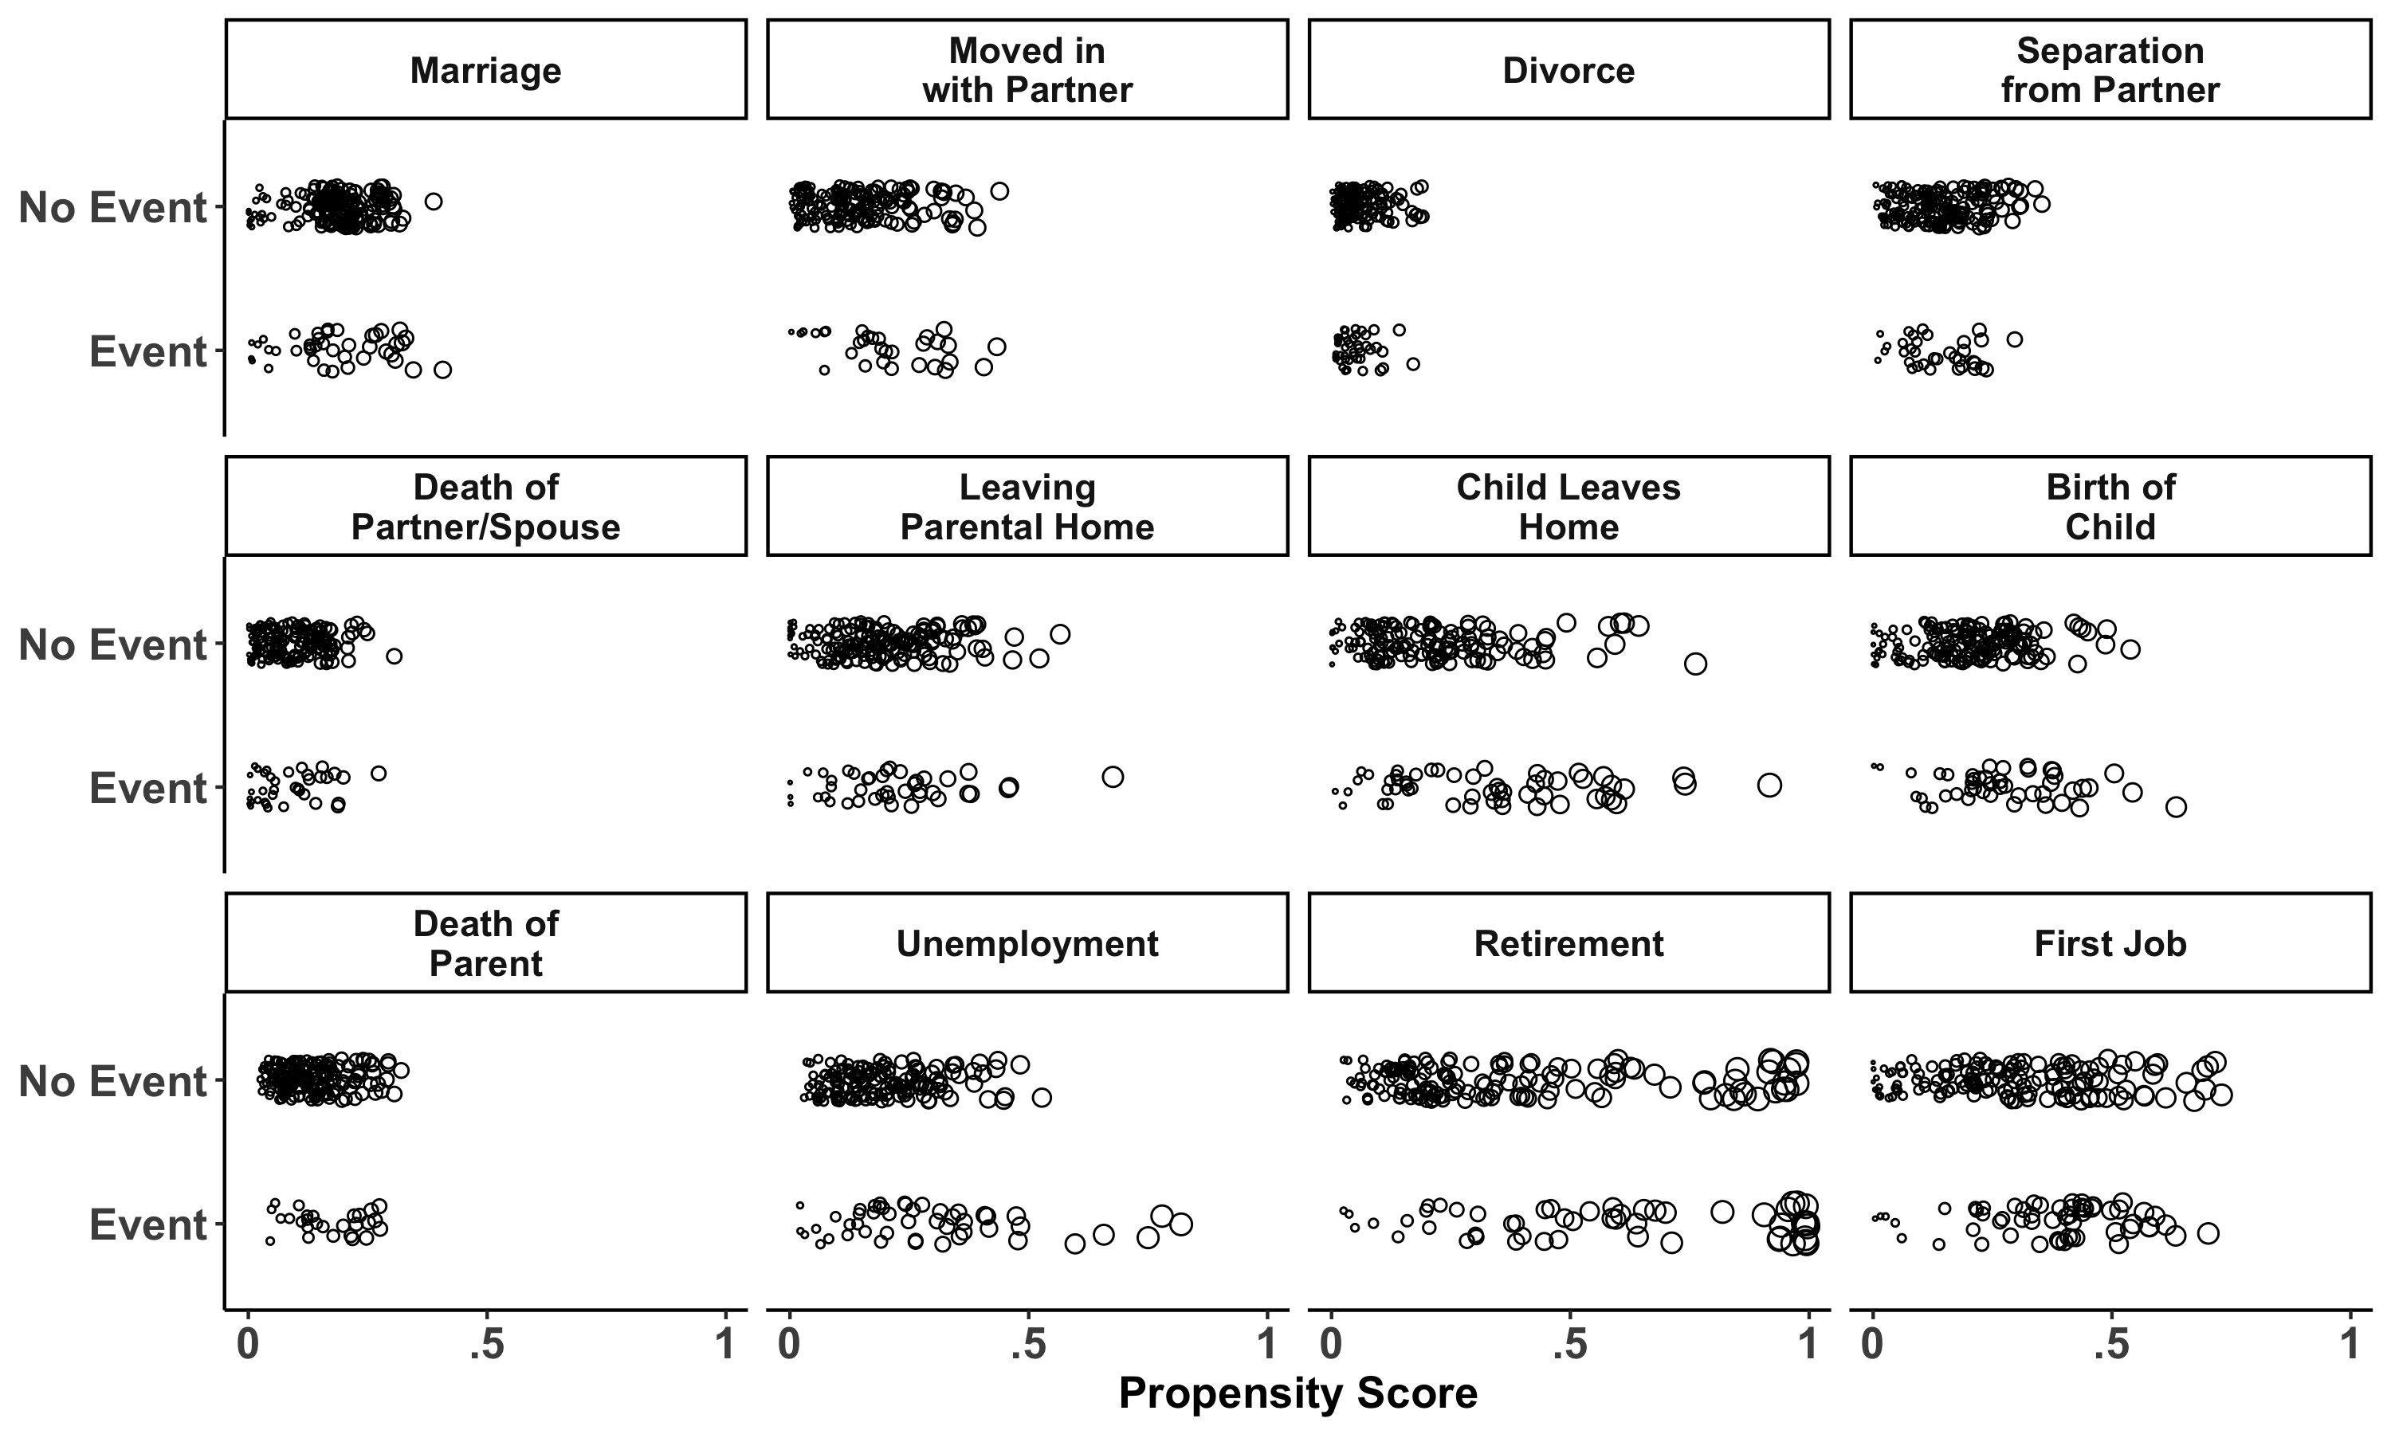

Slide 32
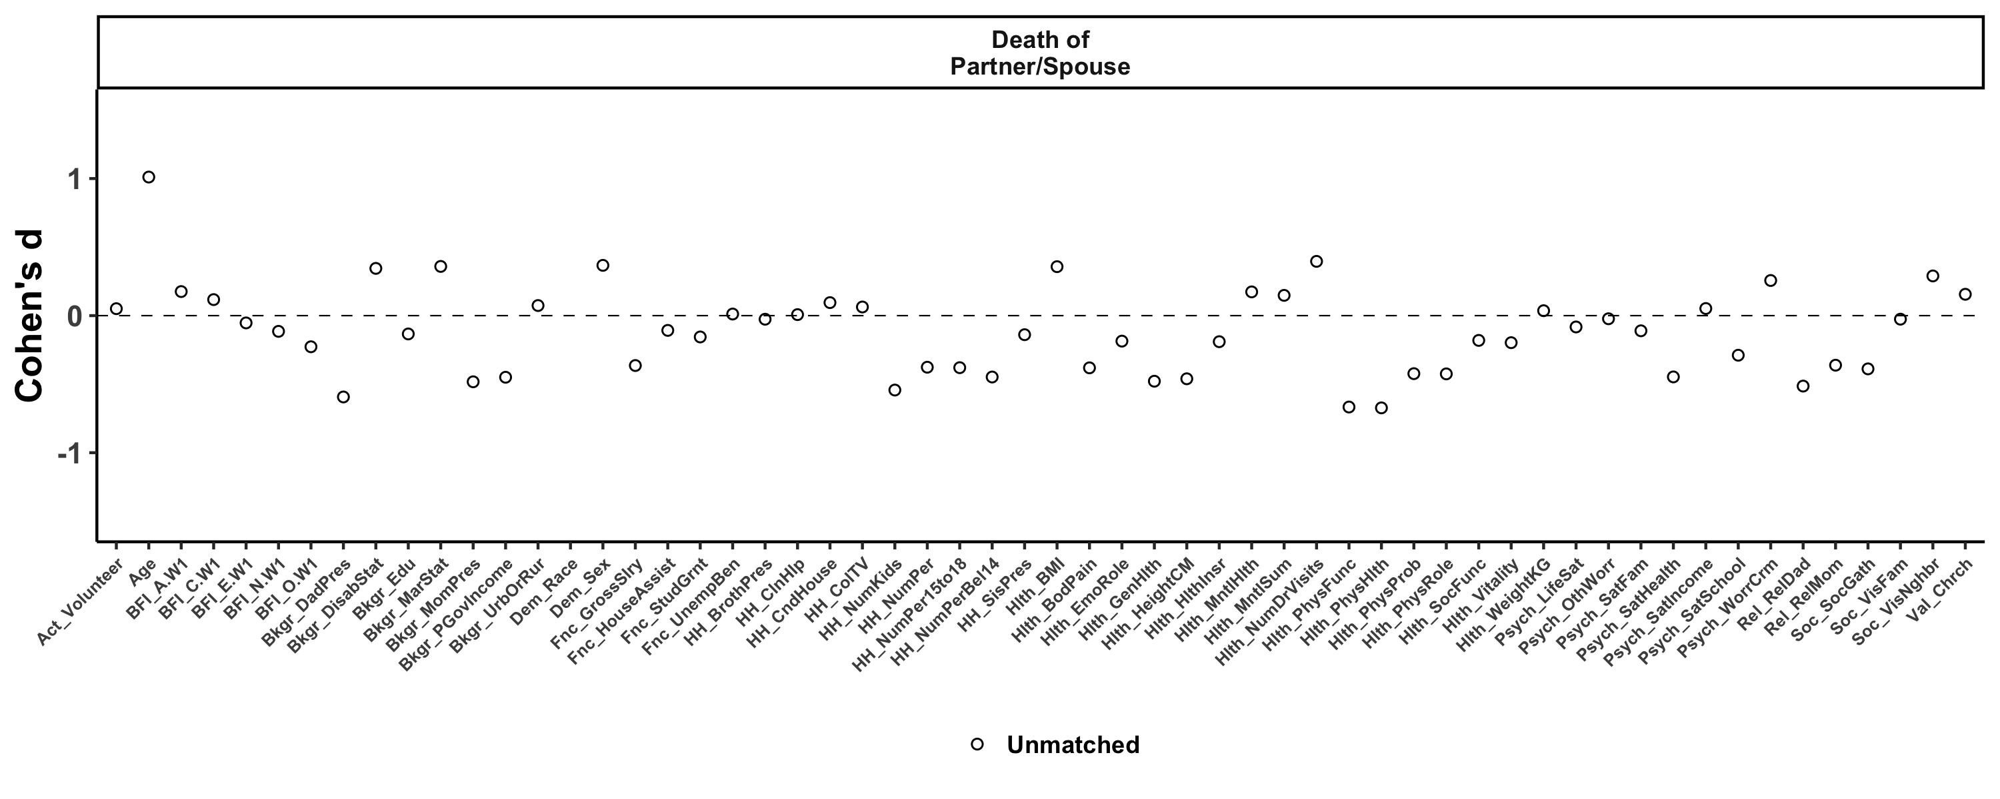
https://emoriebeck.shinyapps.io/life_events/

Slide 33
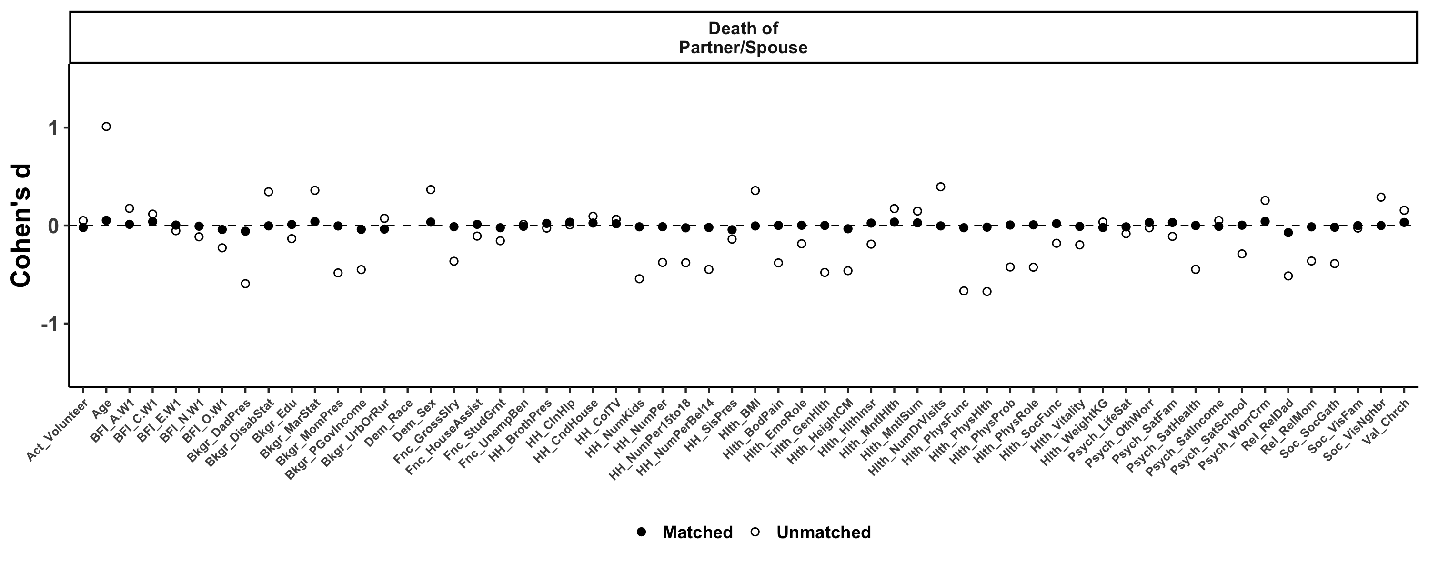
https://emoriebeck.shinyapps.io/life_events/

Slide 34
Results
Selection
E
A
C
N
O
Life Events

Slide 35
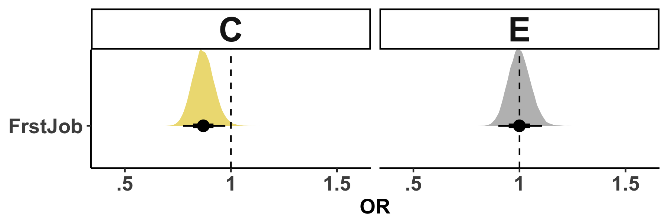
Selection | Socialization | Individual Differences

Slide 36
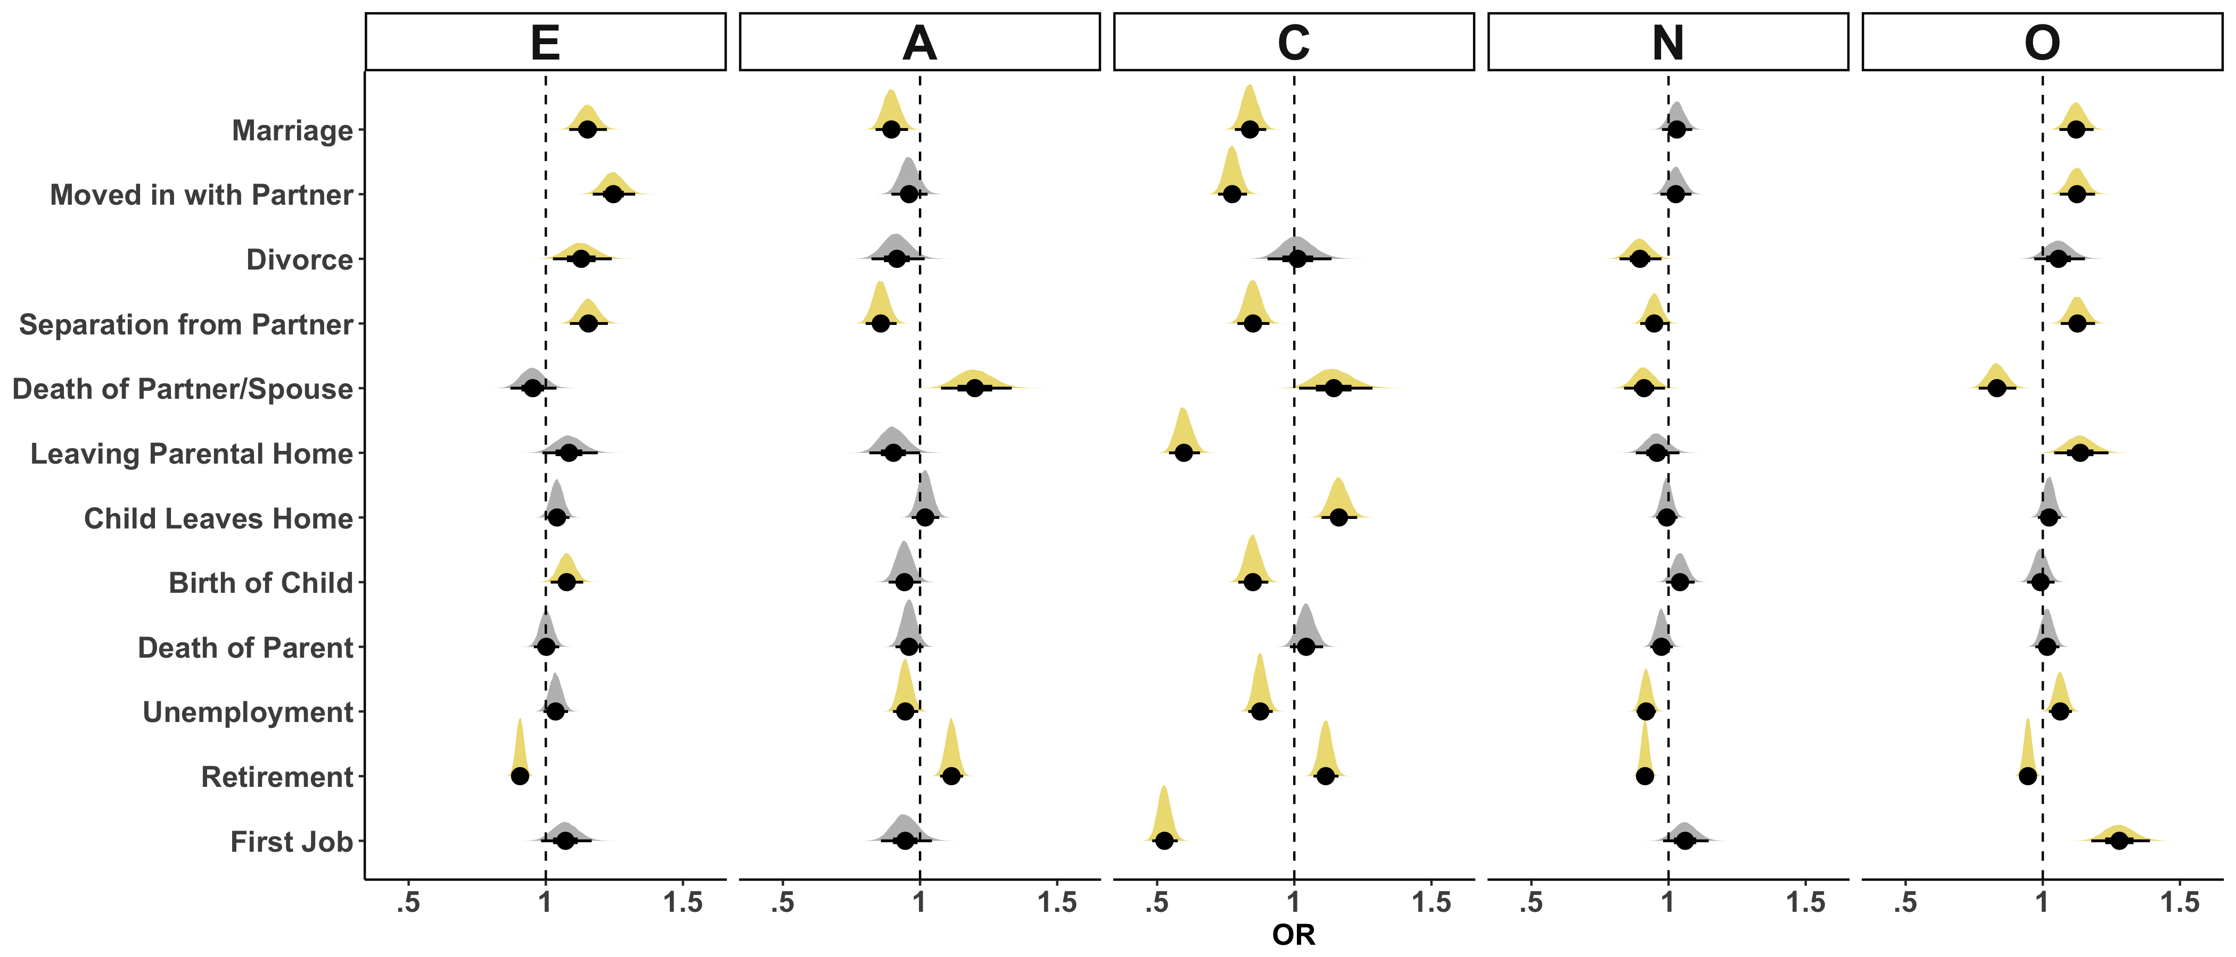
Selection | Socialization | Individual Differences
Unmatched

Slide 37
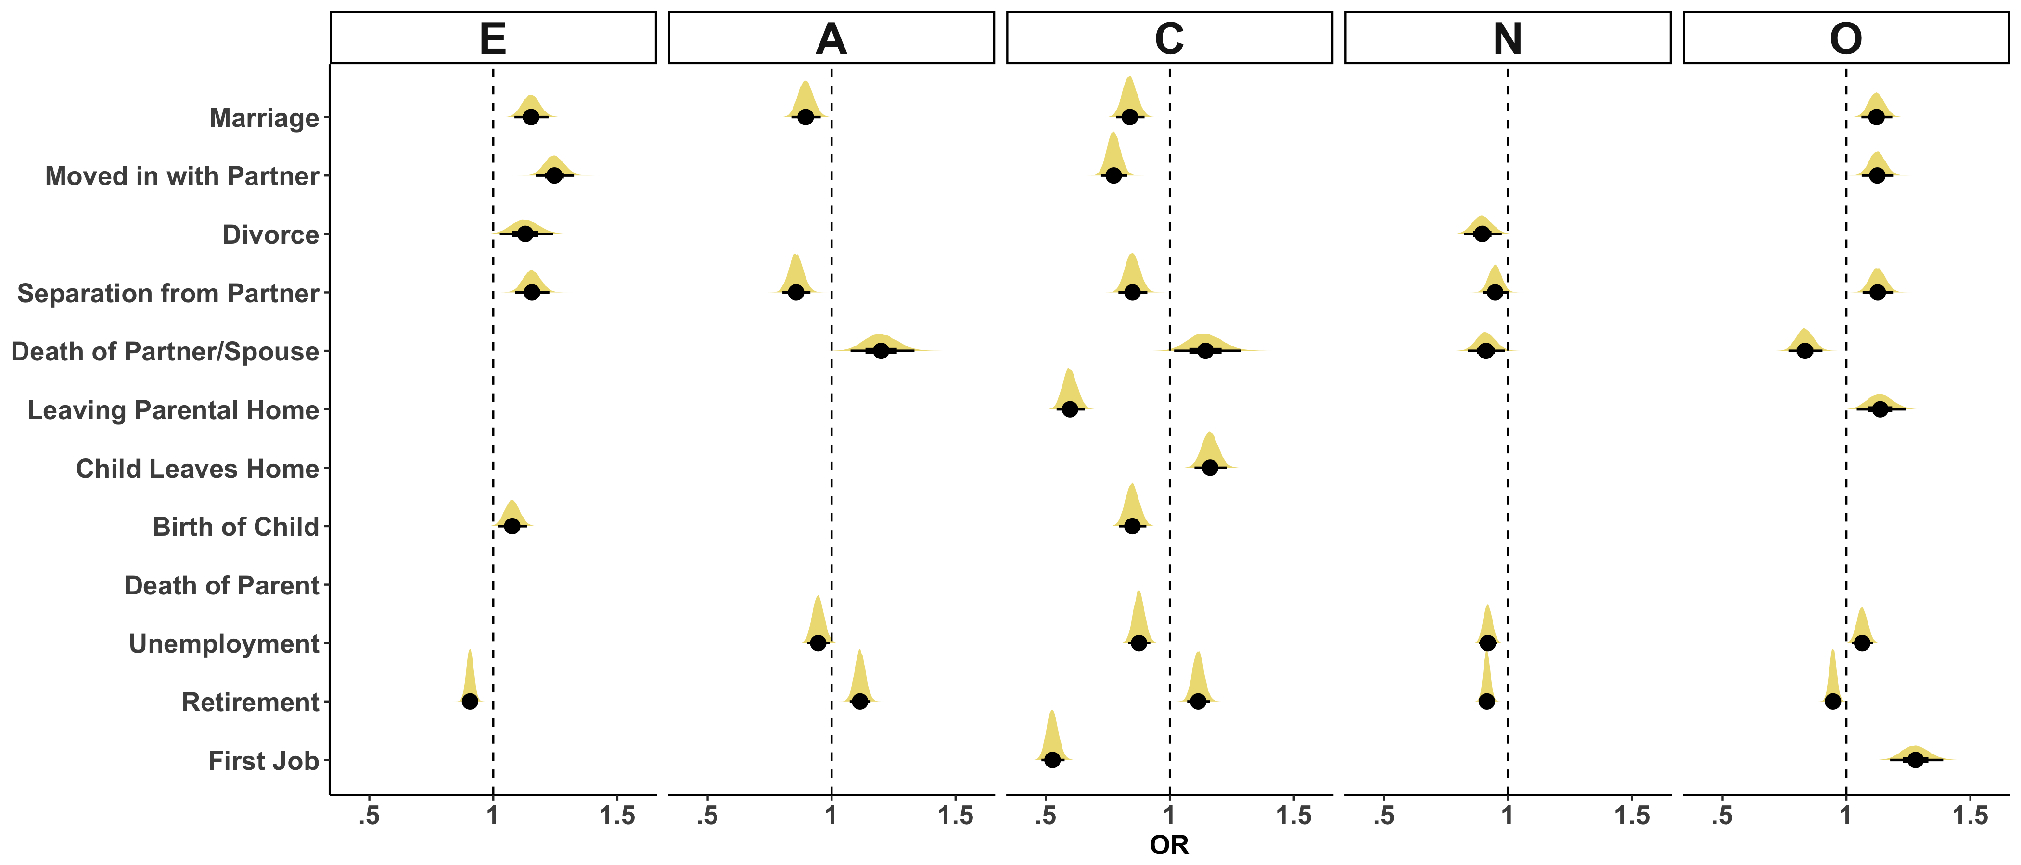
Selection | Socialization | Individual Differences
Unmatched

Slide 38
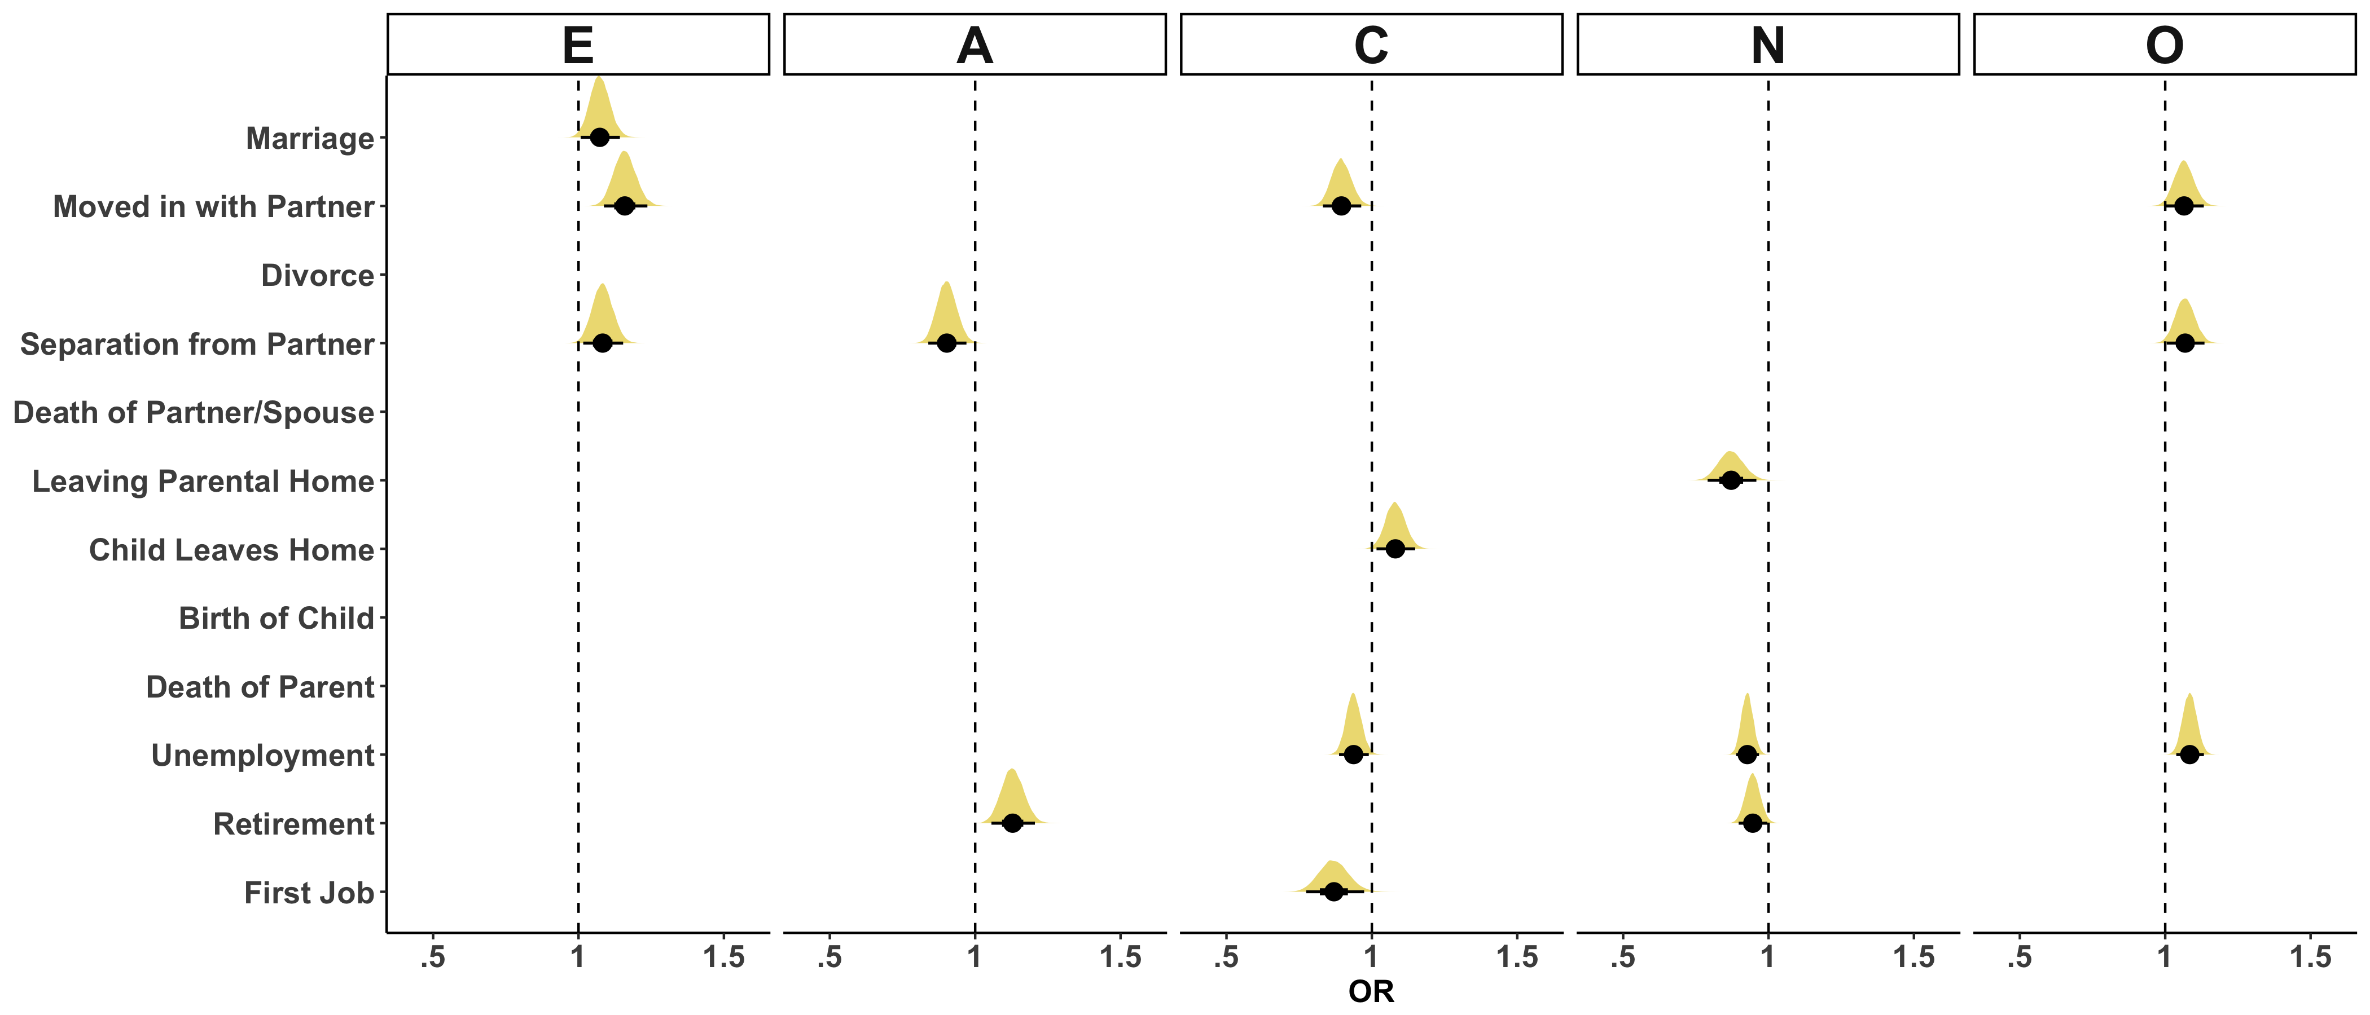
Selection | Socialization | Individual Differences
Matched

Slide 39
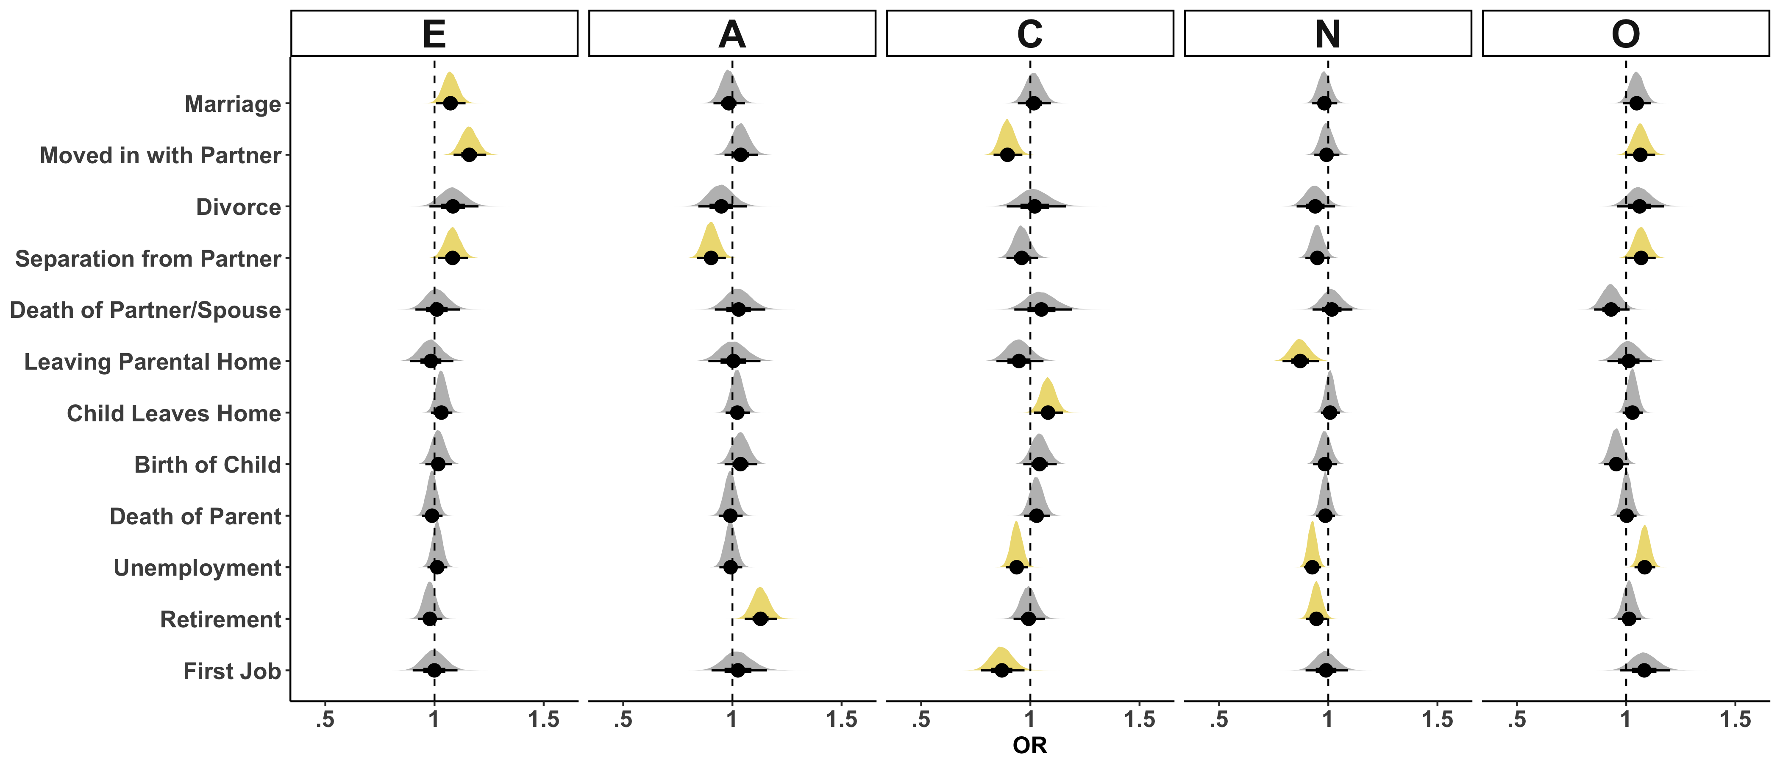
Selection | Socialization | Individual Differences
Matched

Slide 40
Selection | Socialization | Individual Differences
Unmatched

Slide 41
Results
Socialization
E
A
C
N
O
Life Events

Slide 42
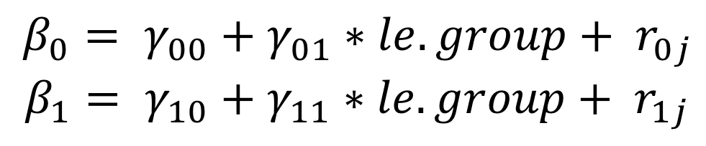
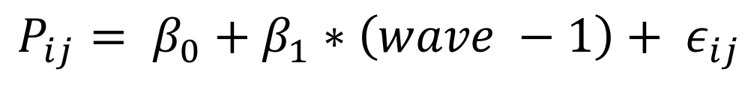
Selection | Socialization | Individual Differences
Level 1:
$$P_{ij}= β_{0}+β_{1}∗\left(wave −1\right)+ ε_{ij}$$
Level 2:
$$β_{0}= γ_{00}+γ_{01}∗le.group+ r_{0j}$$
$$β_{1}= γ_{10}+γ_{11}∗le.group+ r_{1j}$$
No Event: $P_{ij}={γ_{00}+ γ}_{10} ∗\left(wave −1\right)$
Event: $P_{ij}={γ_{00}+ γ_{01}+(γ}_{10}+γ_{11})∗\left(wave −1\right)$

Slide 43
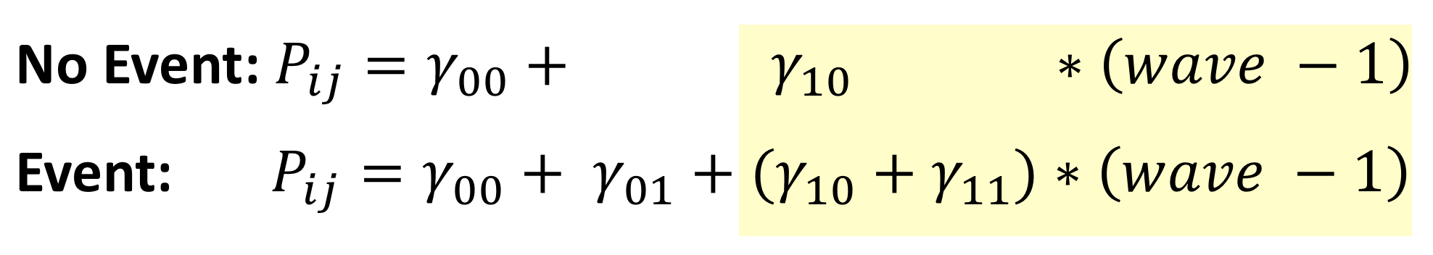
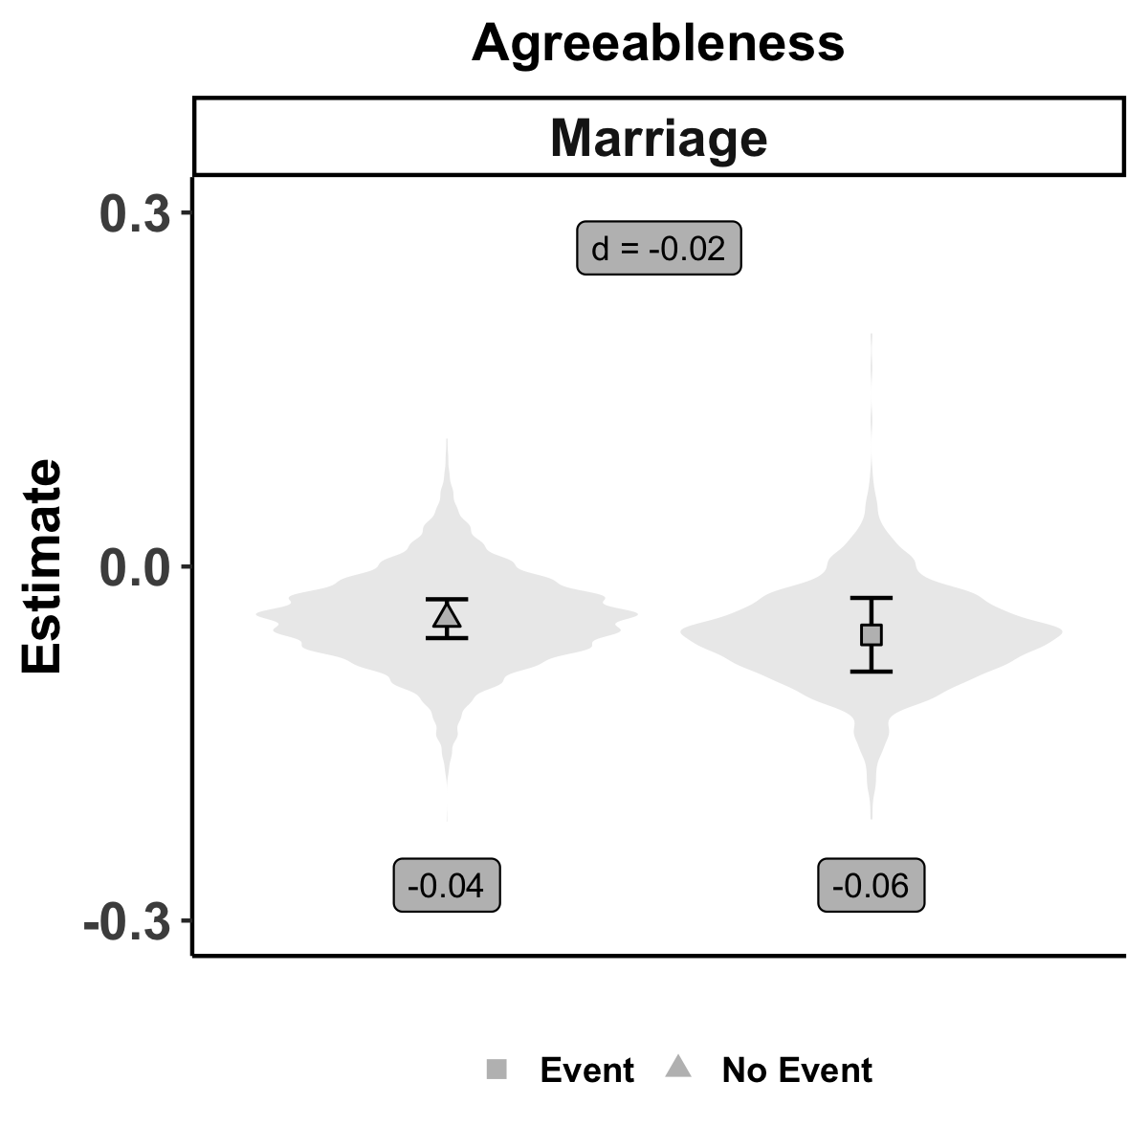
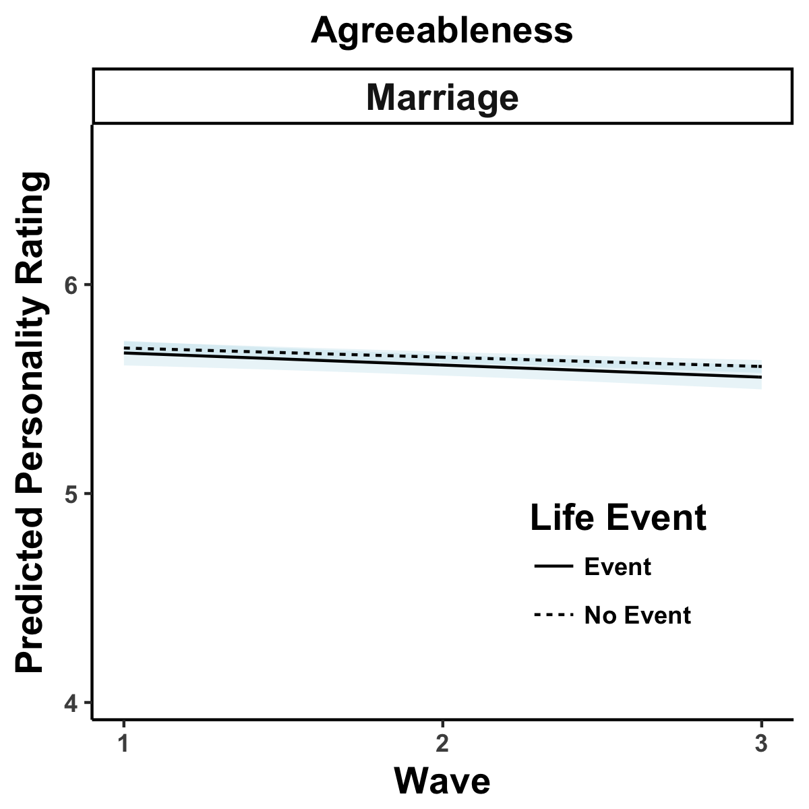
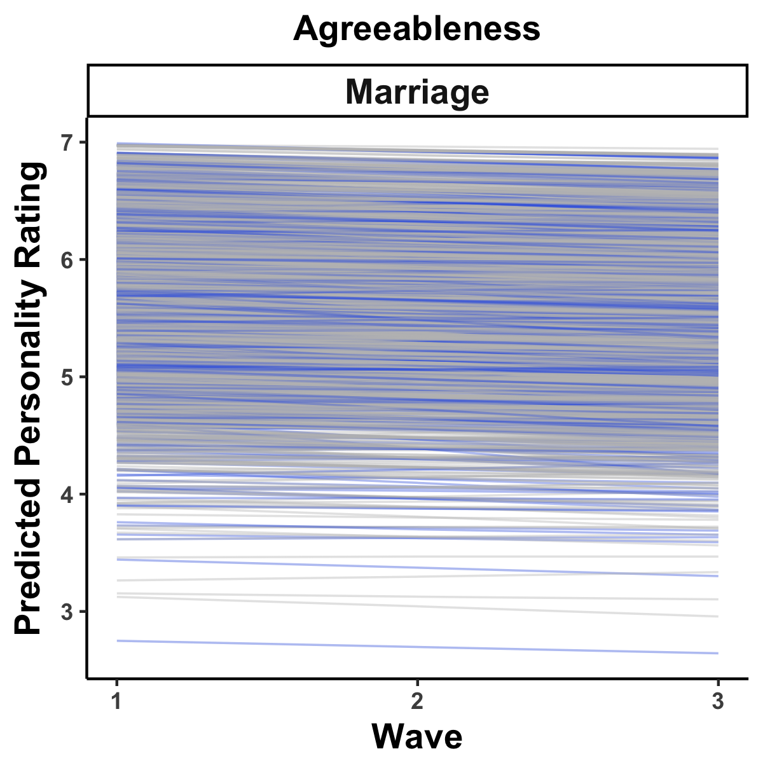
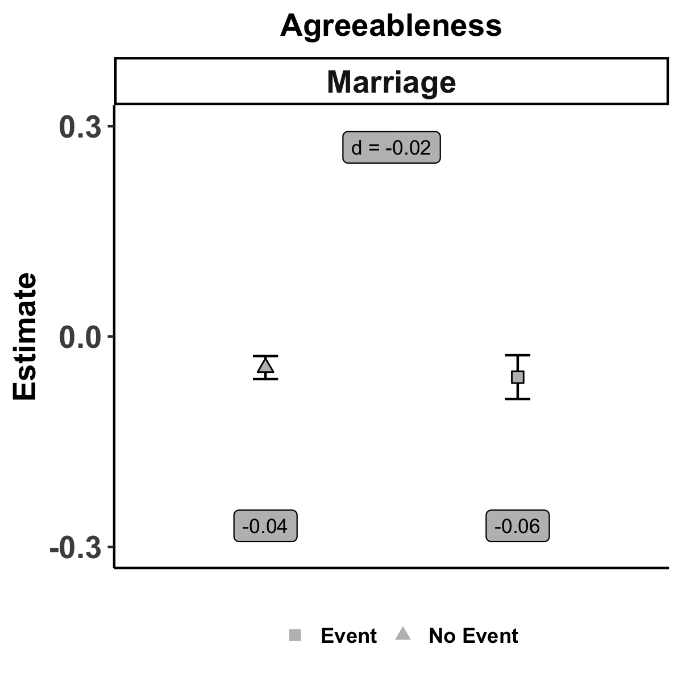
Selection | Socialization | Individual Differences

Slide 44
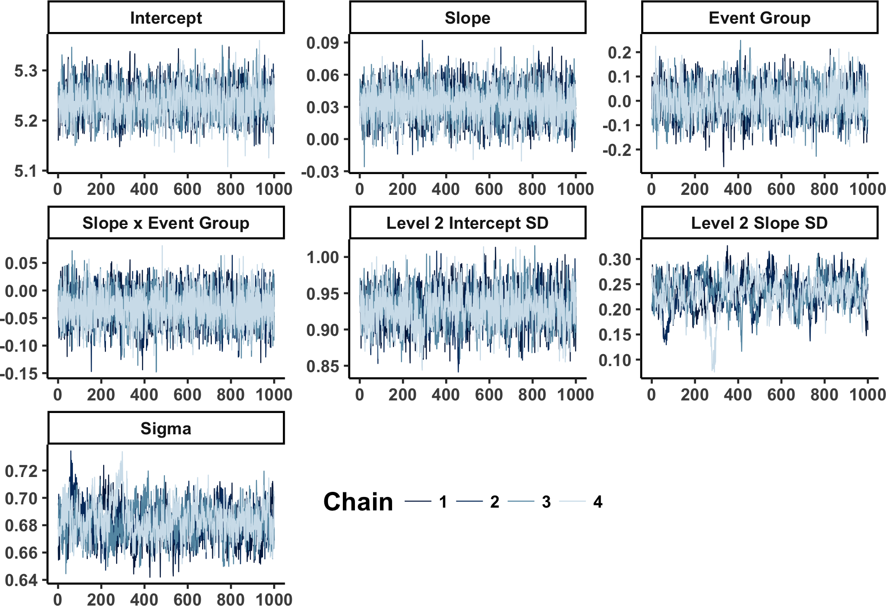
Selection | Socialization | Individual Differences
Notes:
Trace plot of Markov chain from one multiply imputed Bayseian multilevel growth model. In this sample, the examined trait was Extraversion, and the life event was the a moving out of one's parents' home. This is a healthy Markov chain that exhibits both stationarity and well-mixing. The iterations represent only post-warmup samples.

Slide 45
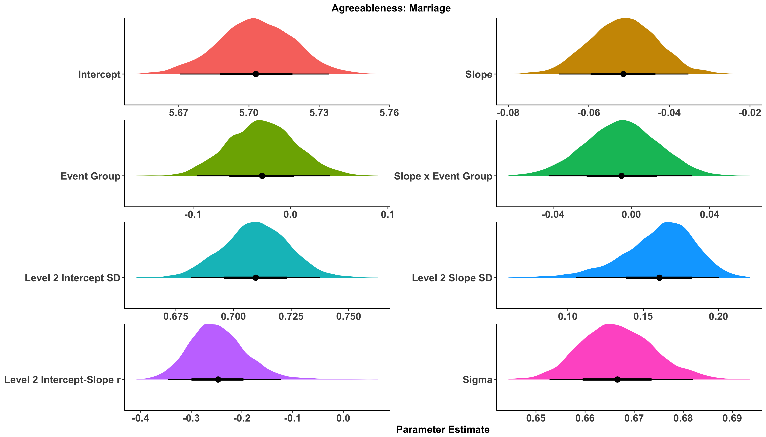
Selection | Socialization | Individual Differences
https://emoriebeck.shinyapps.io/life_events/

Slide 46
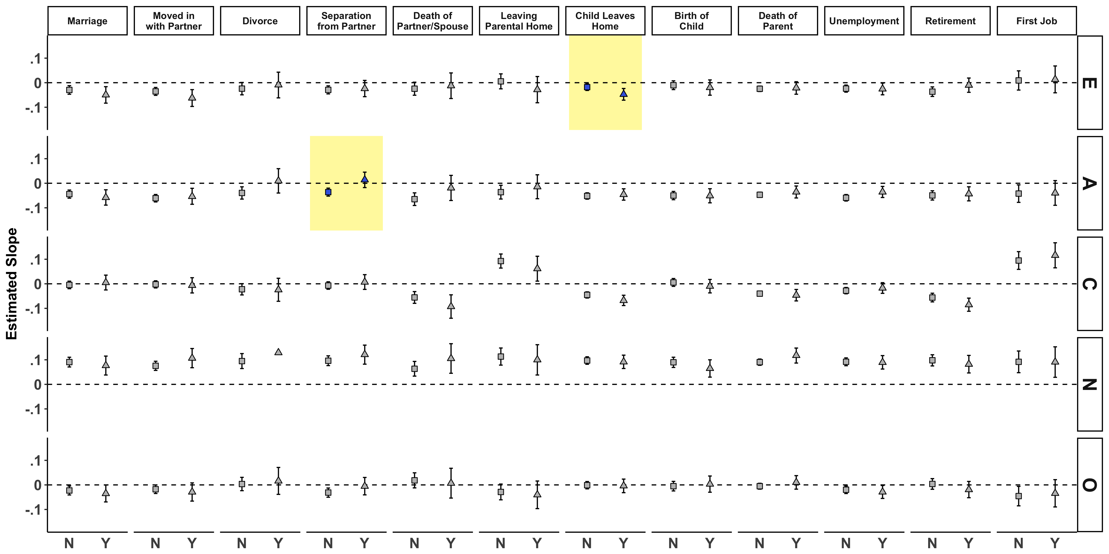
Selection | Socialization | Individual Differences

Slide 47
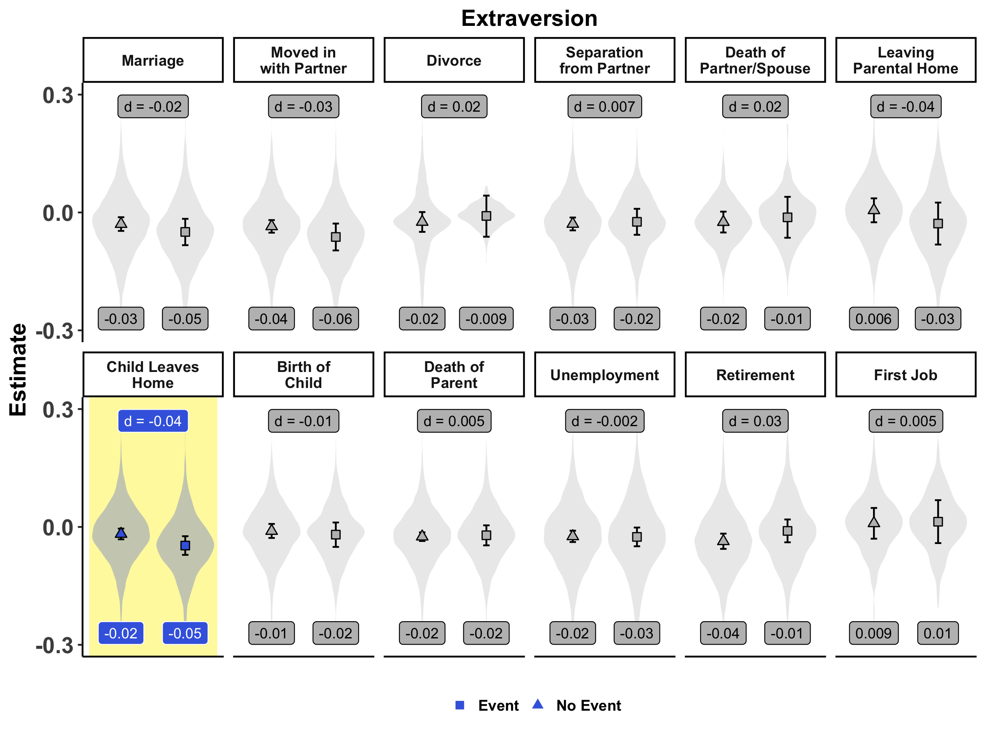
Selection | Socialization | Individual Differences

Slide 48
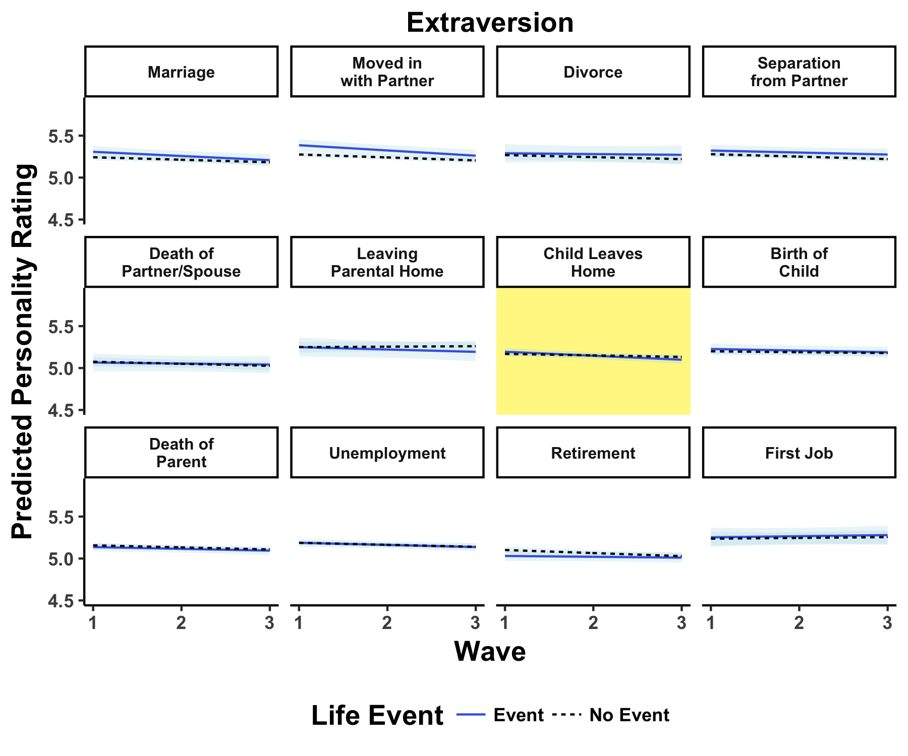
Selection | Socialization | Individual Differences

Slide 49
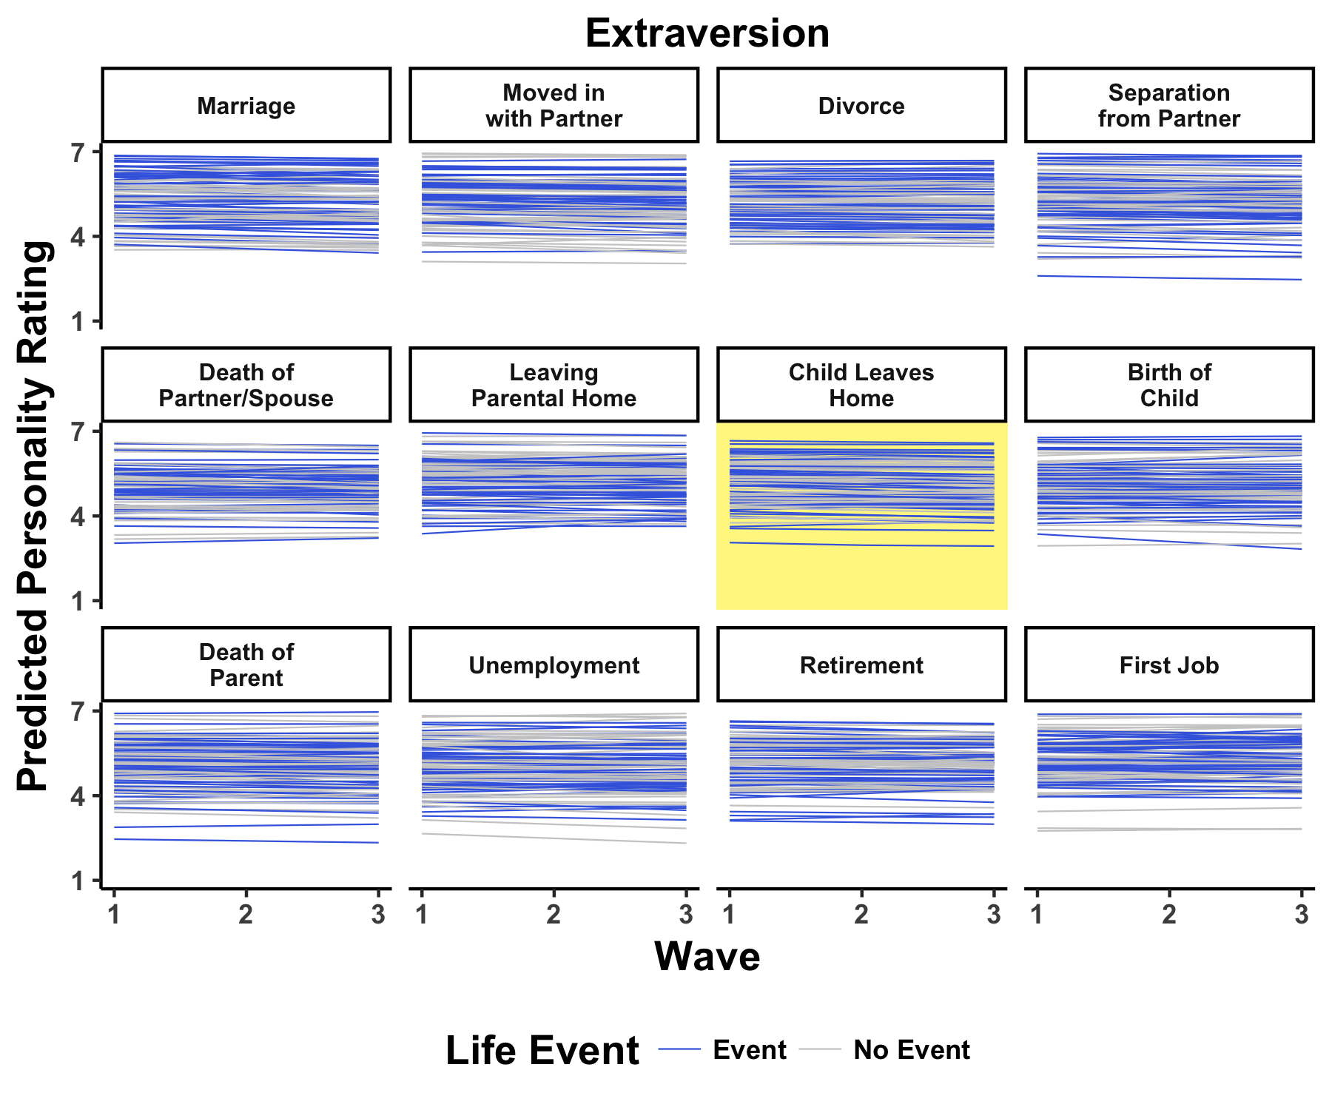
Selection | Socialization | Individual Differences

Slide 50
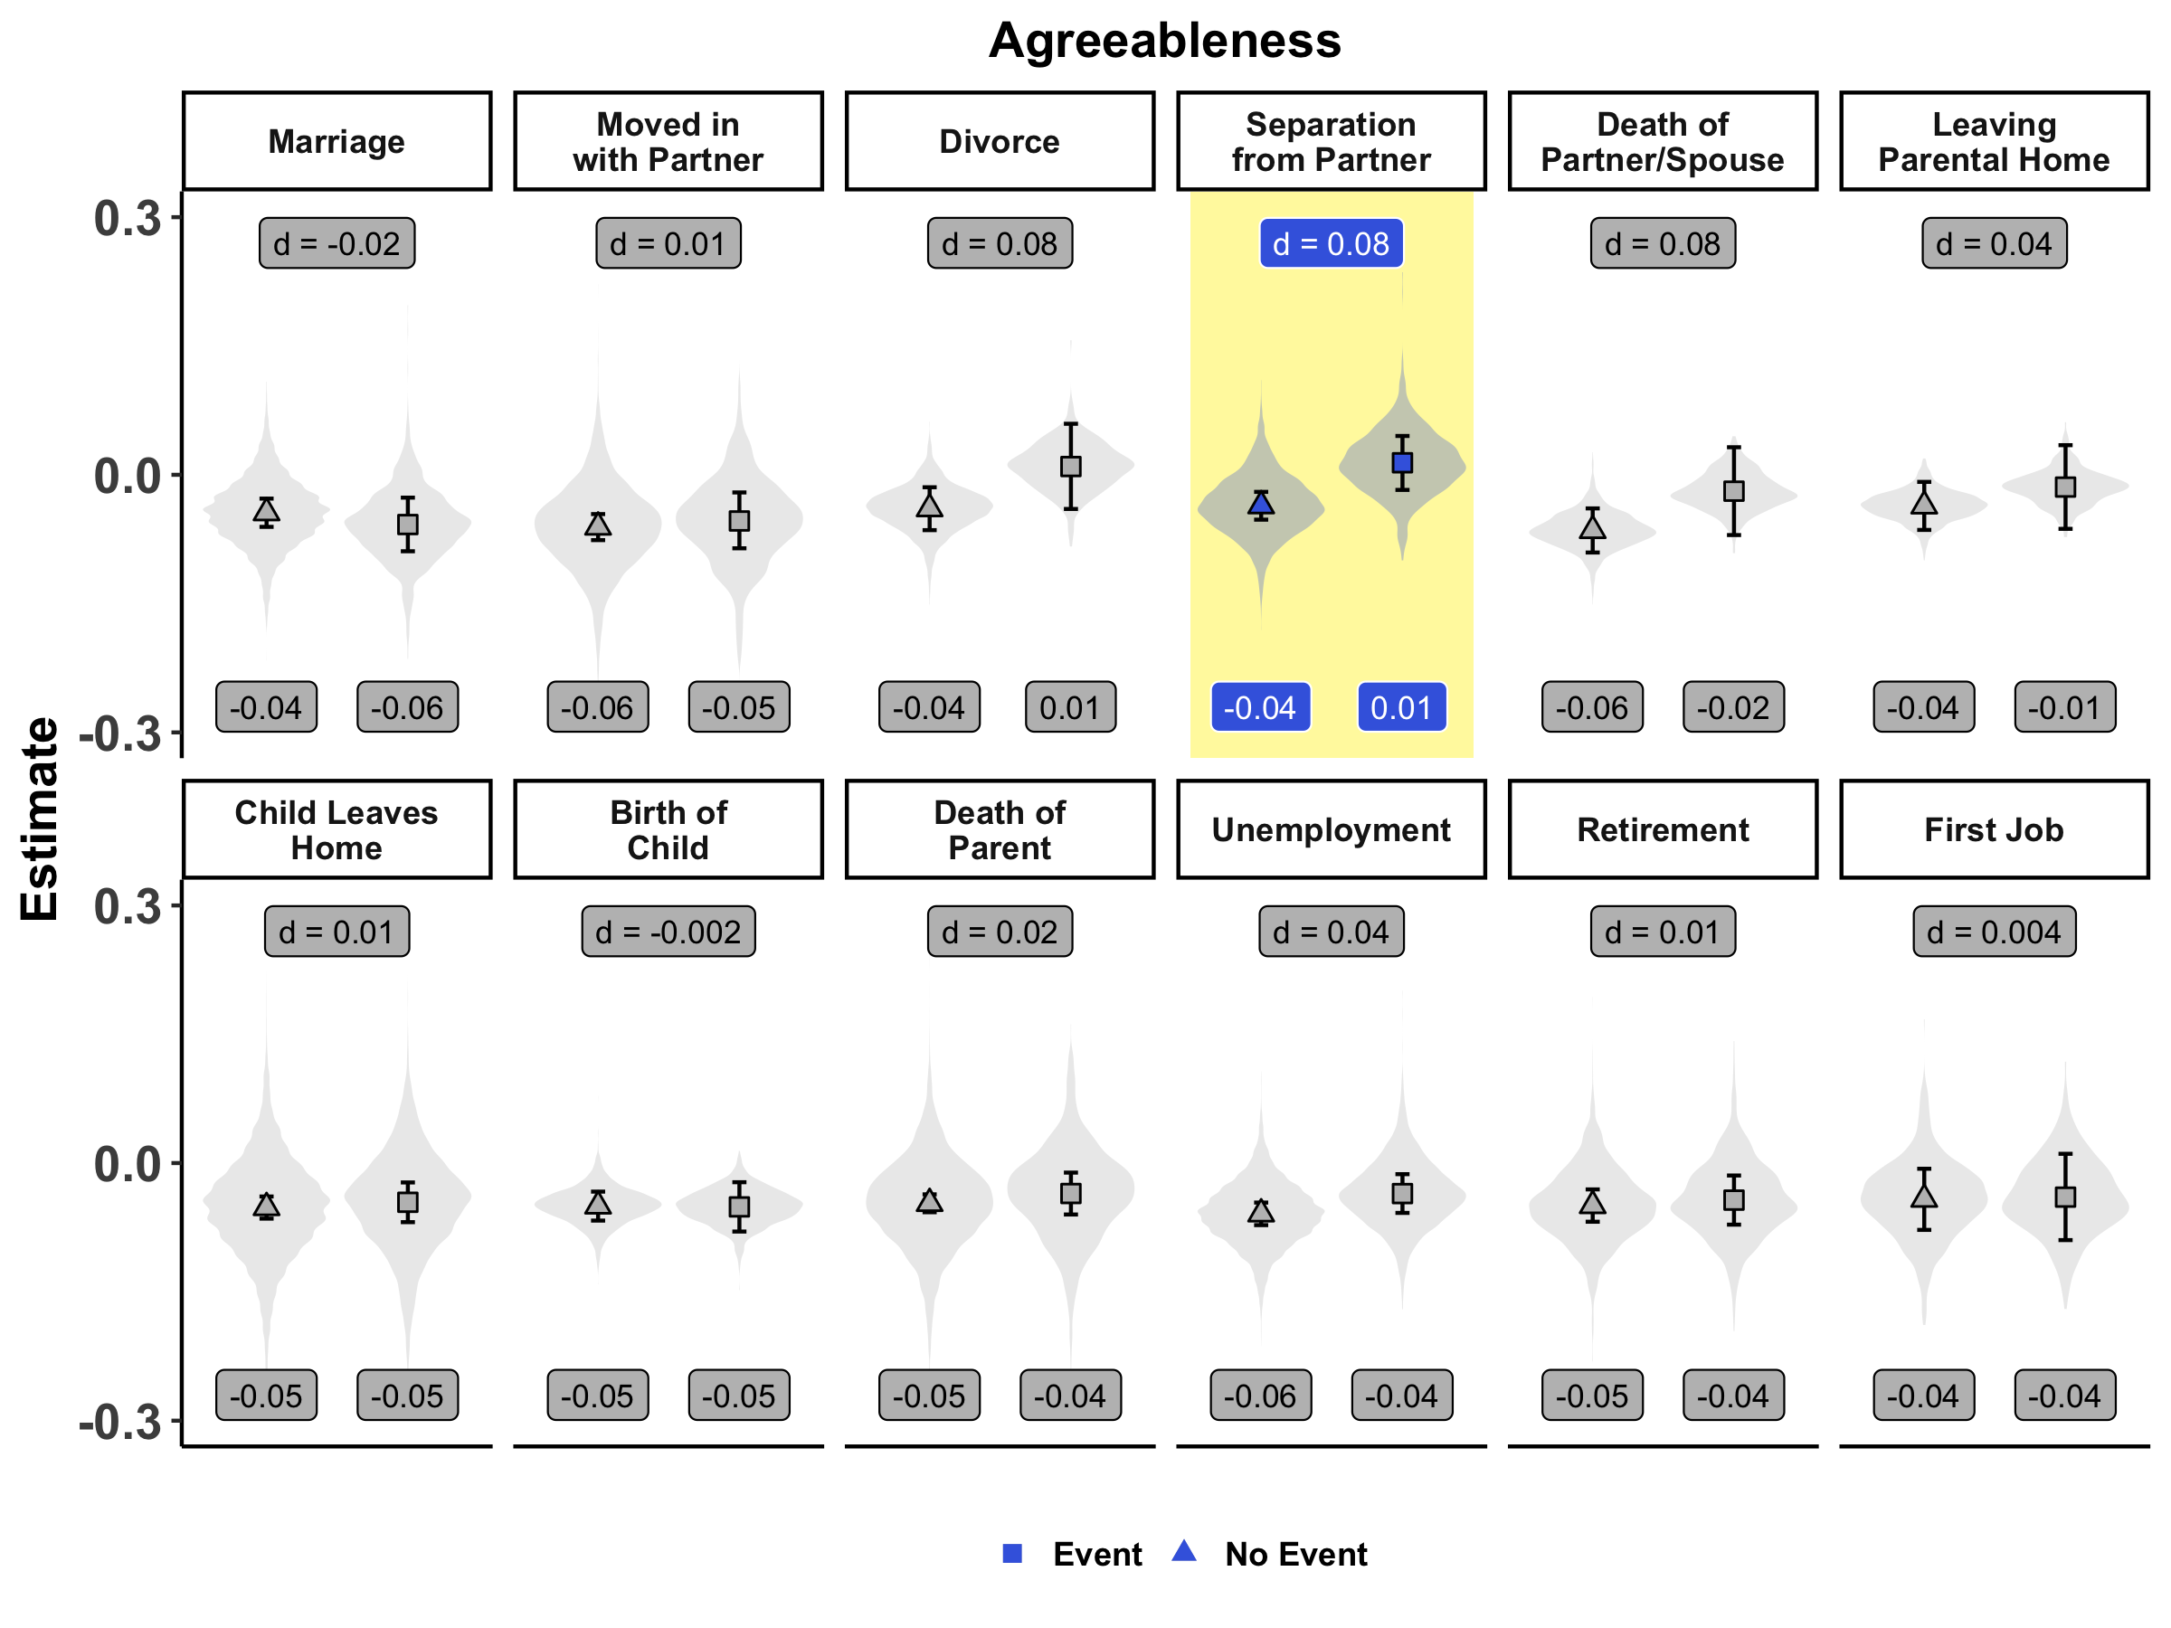
Selection | Socialization | Individual Differences
Notes:
cohen's d looks wrong

Slide 51
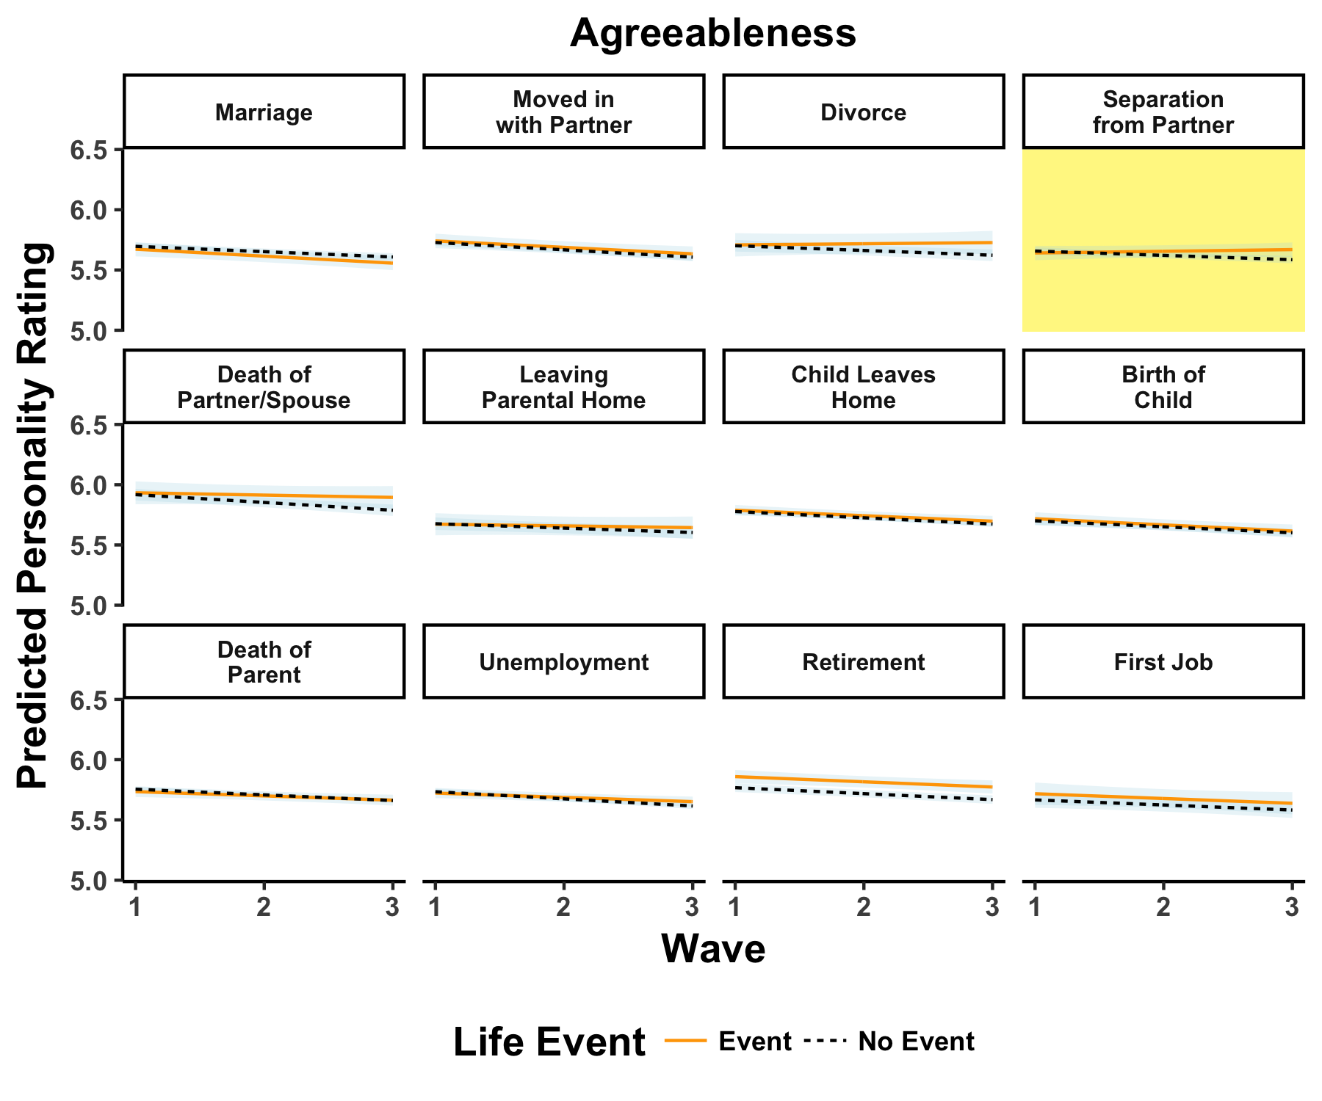
Selection | Socialization | Individual Differences

Slide 52
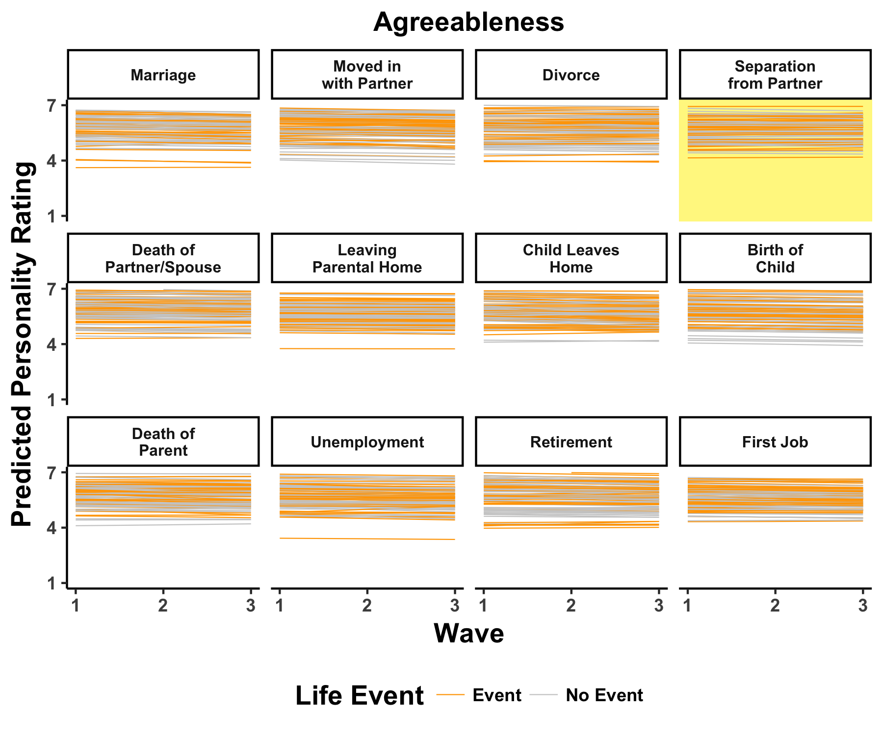
Selection | Socialization | Individual Differences

Slide 53
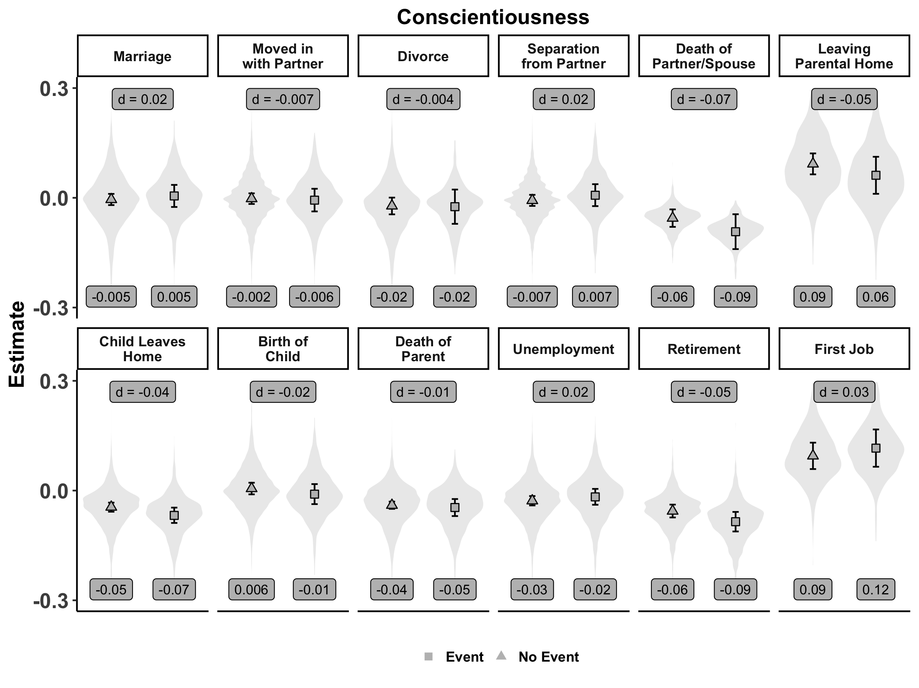
Selection | Socialization | Individual Differences

Slide 54
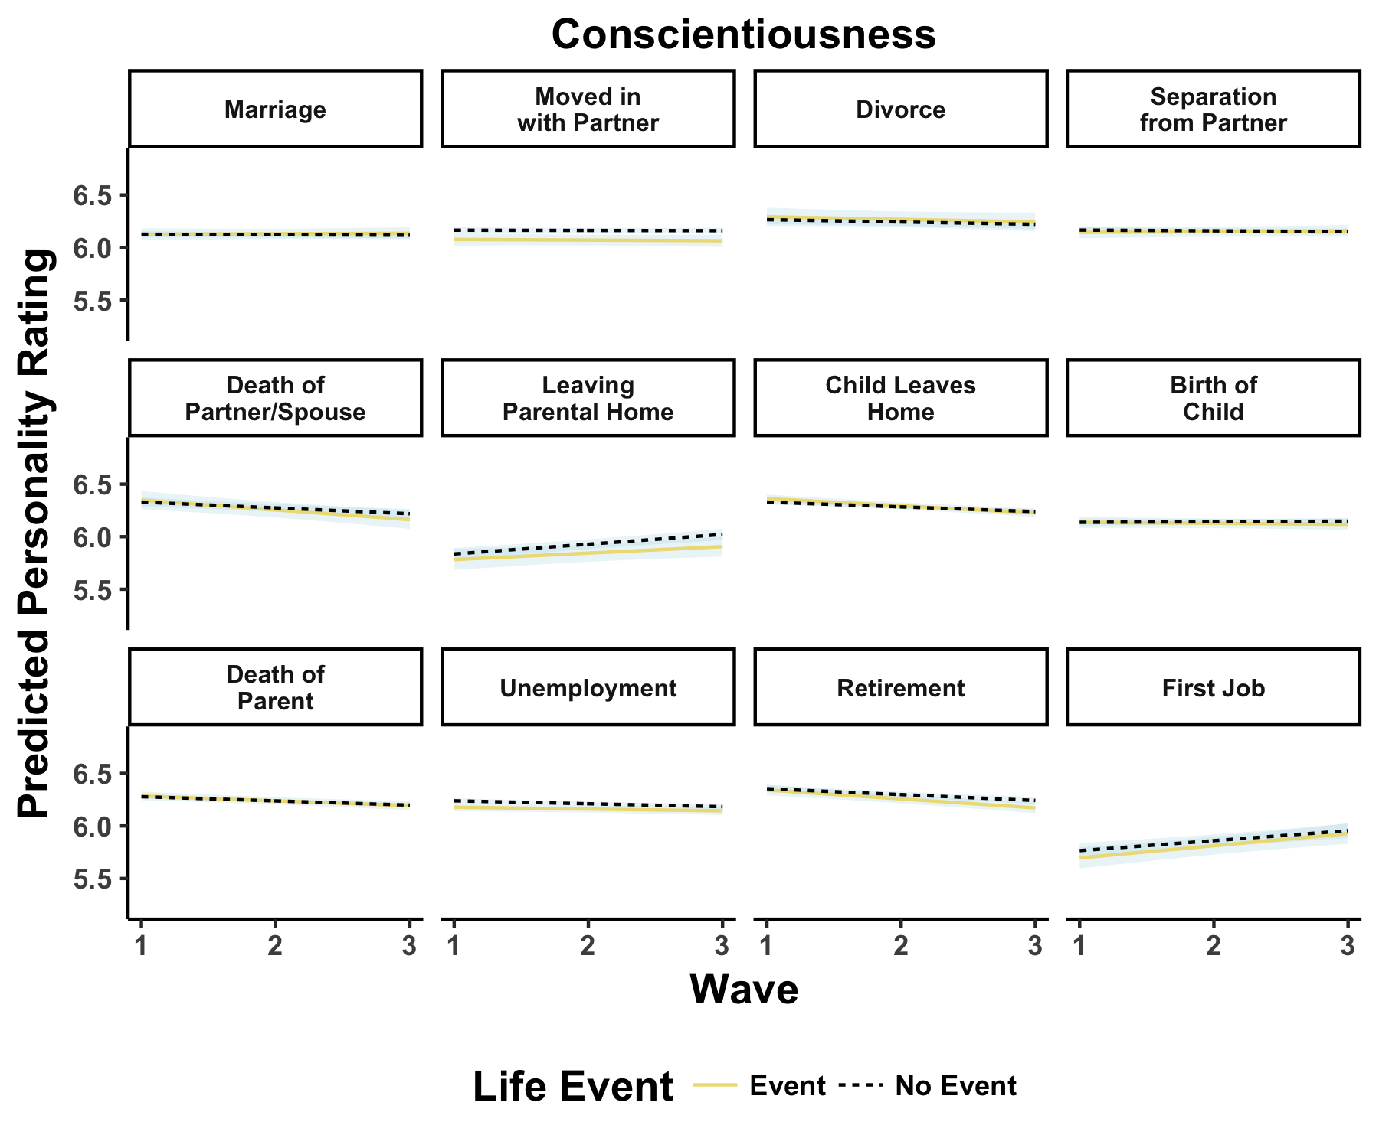
Selection | Socialization | Individual Differences

Slide 55
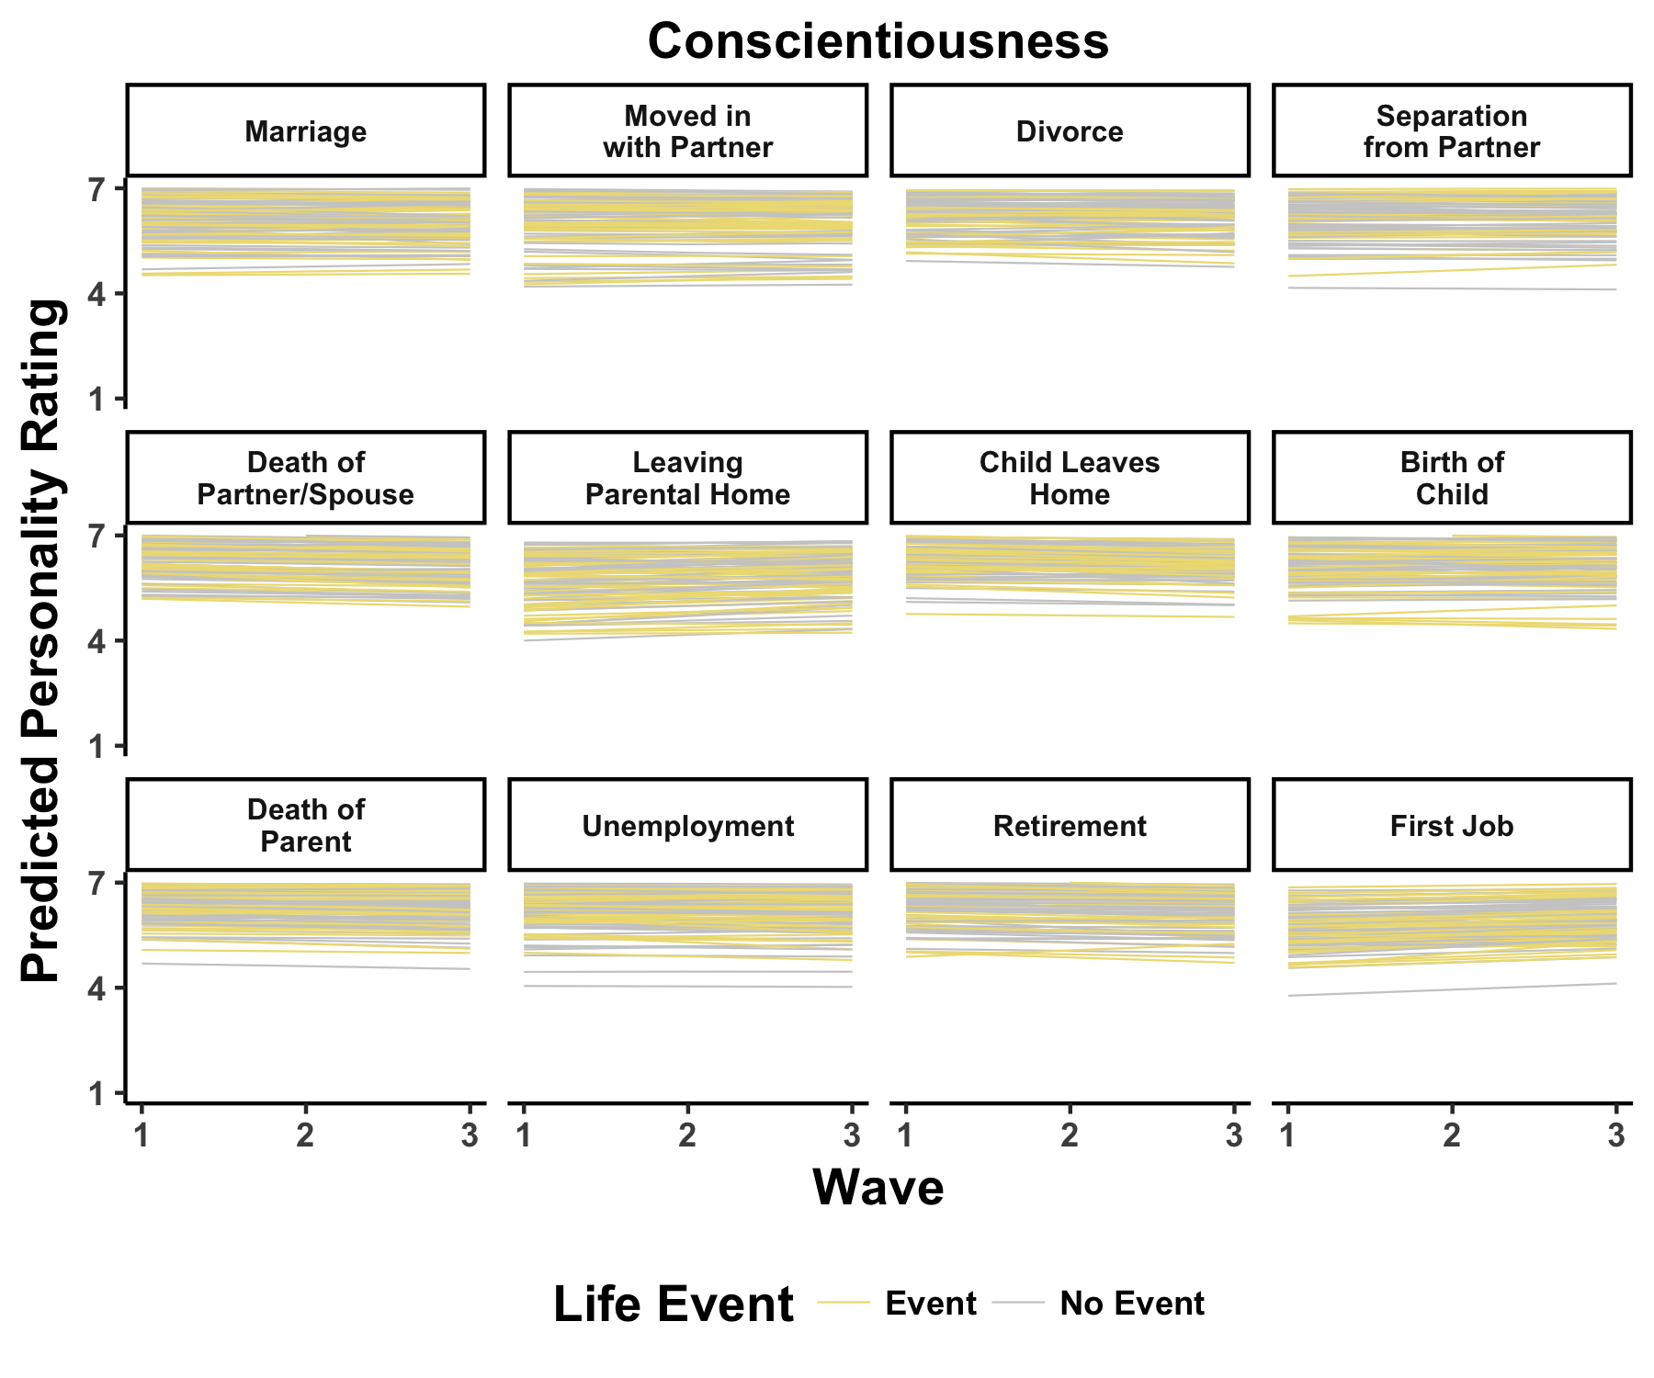
Selection | Socialization | Individual Differences

Slide 56
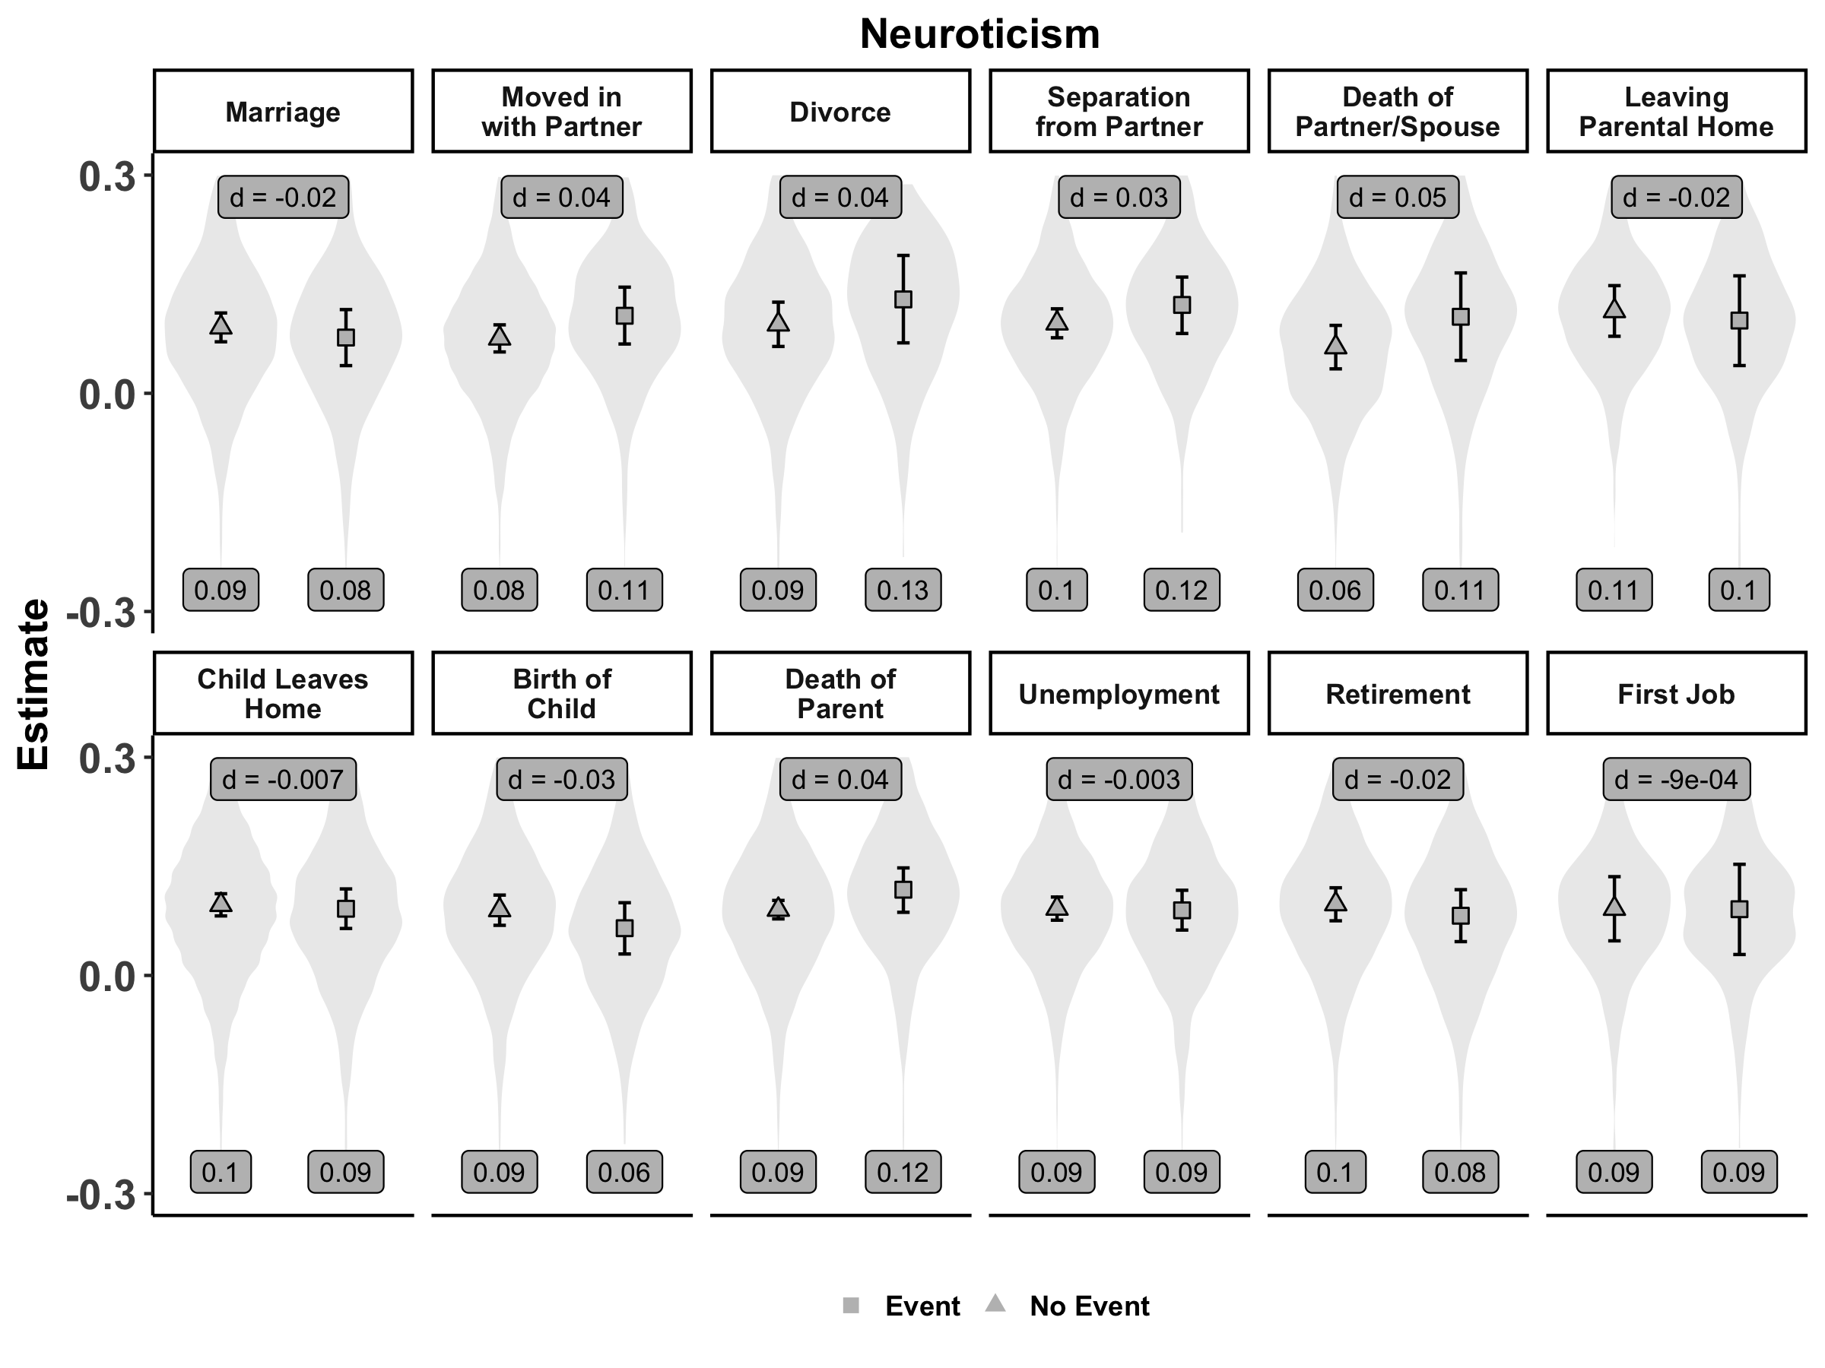
Selection | Socialization | Individual Differences

Slide 57
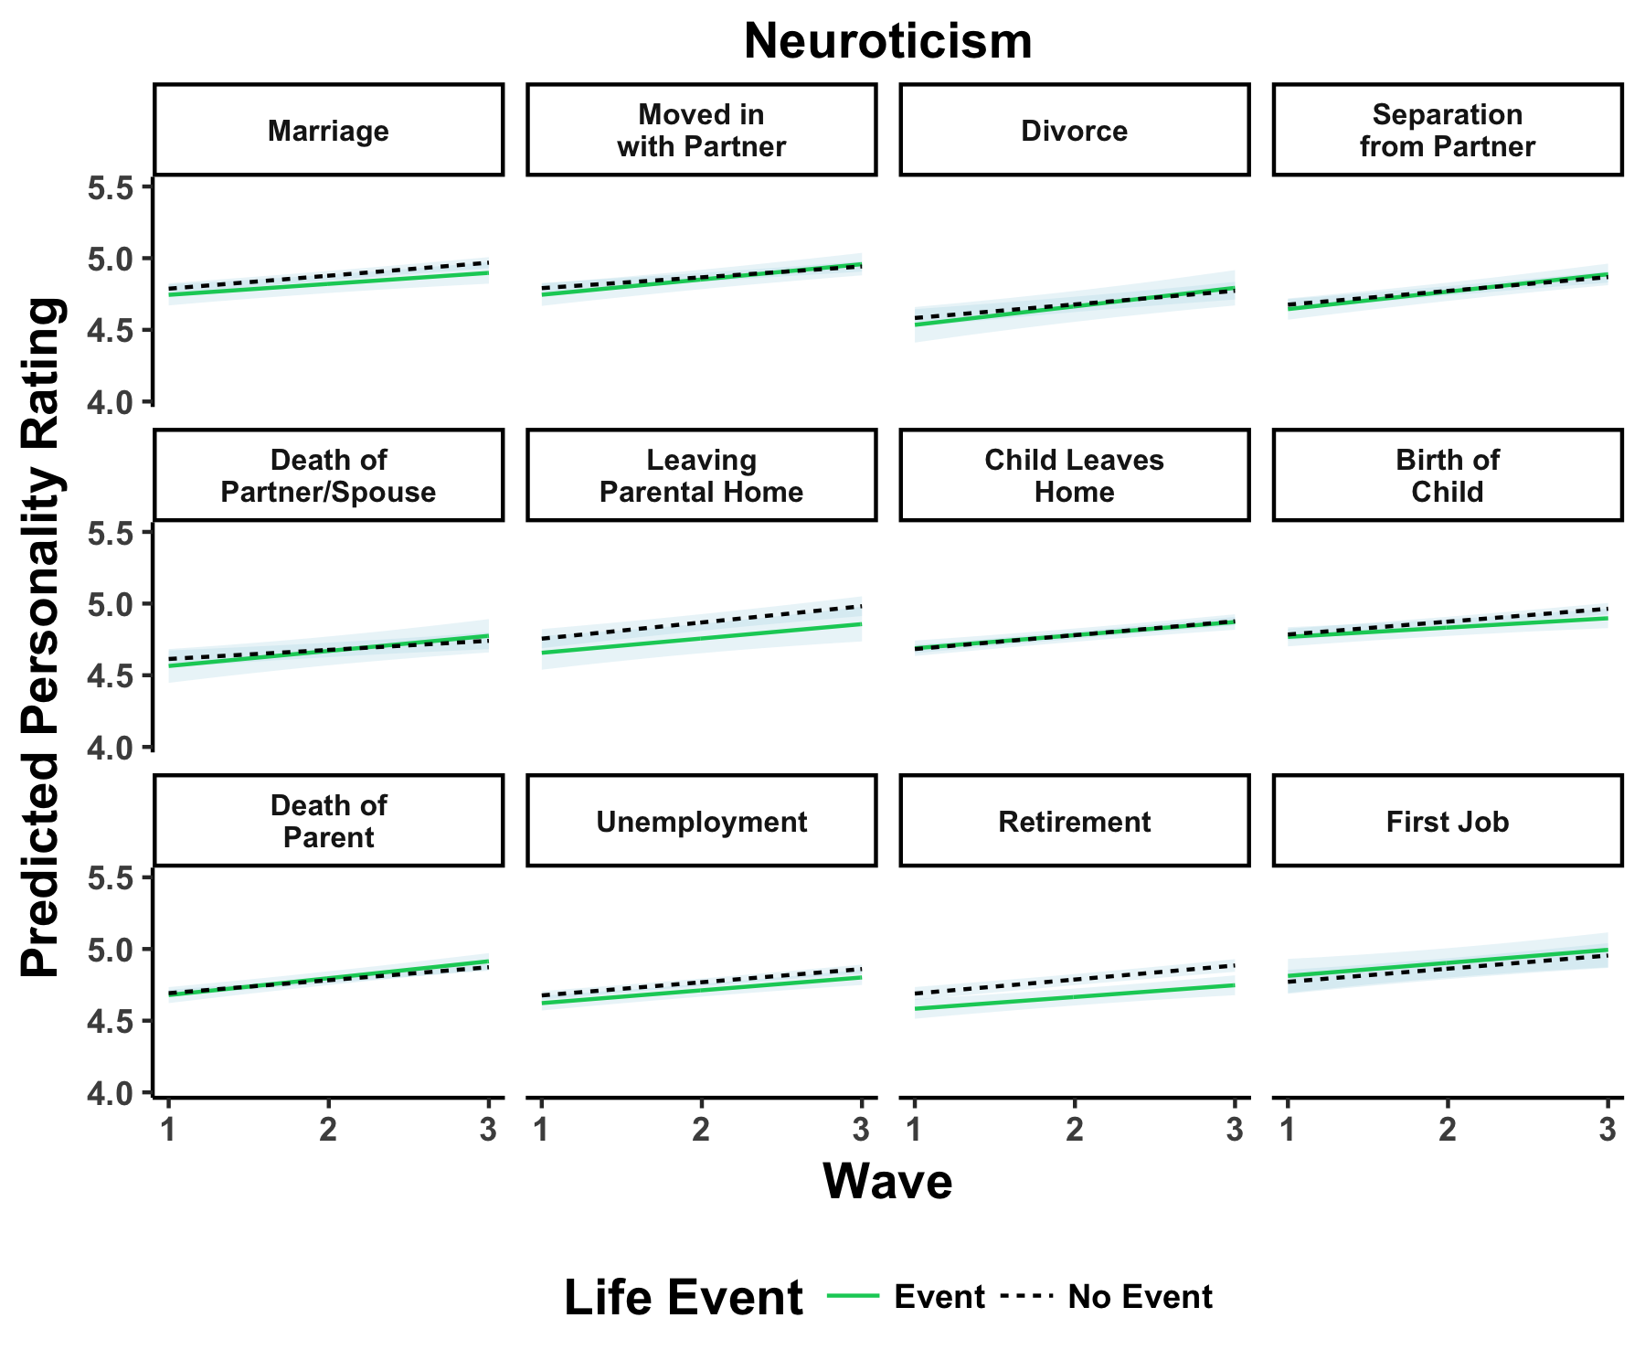
Selection | Socialization | Individual Differences

Slide 58
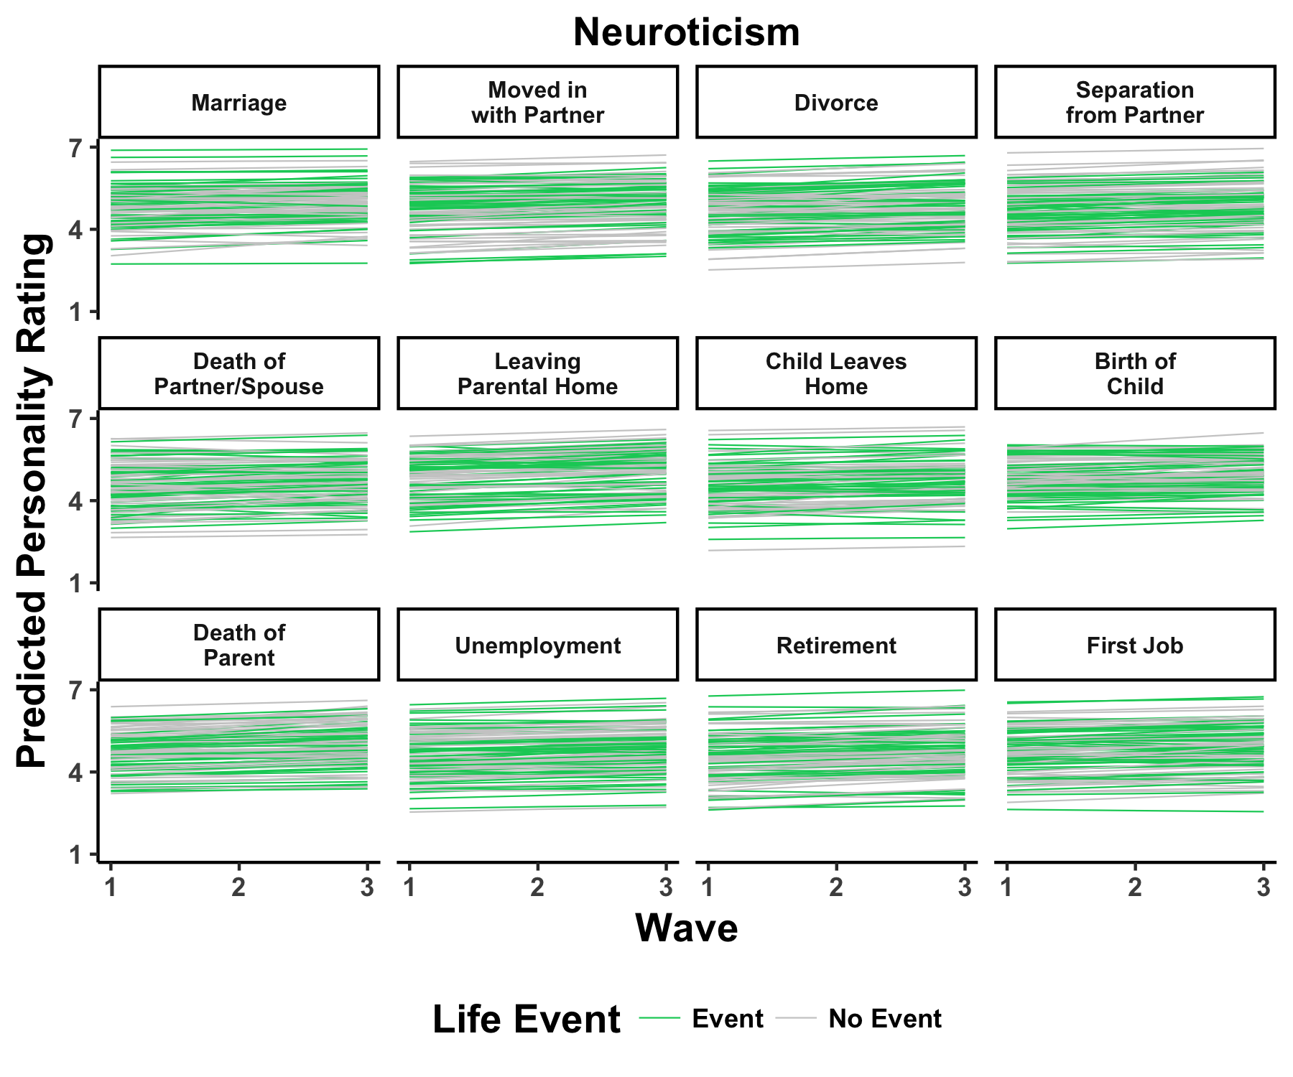
Selection | Socialization | Individual Differences

Slide 59
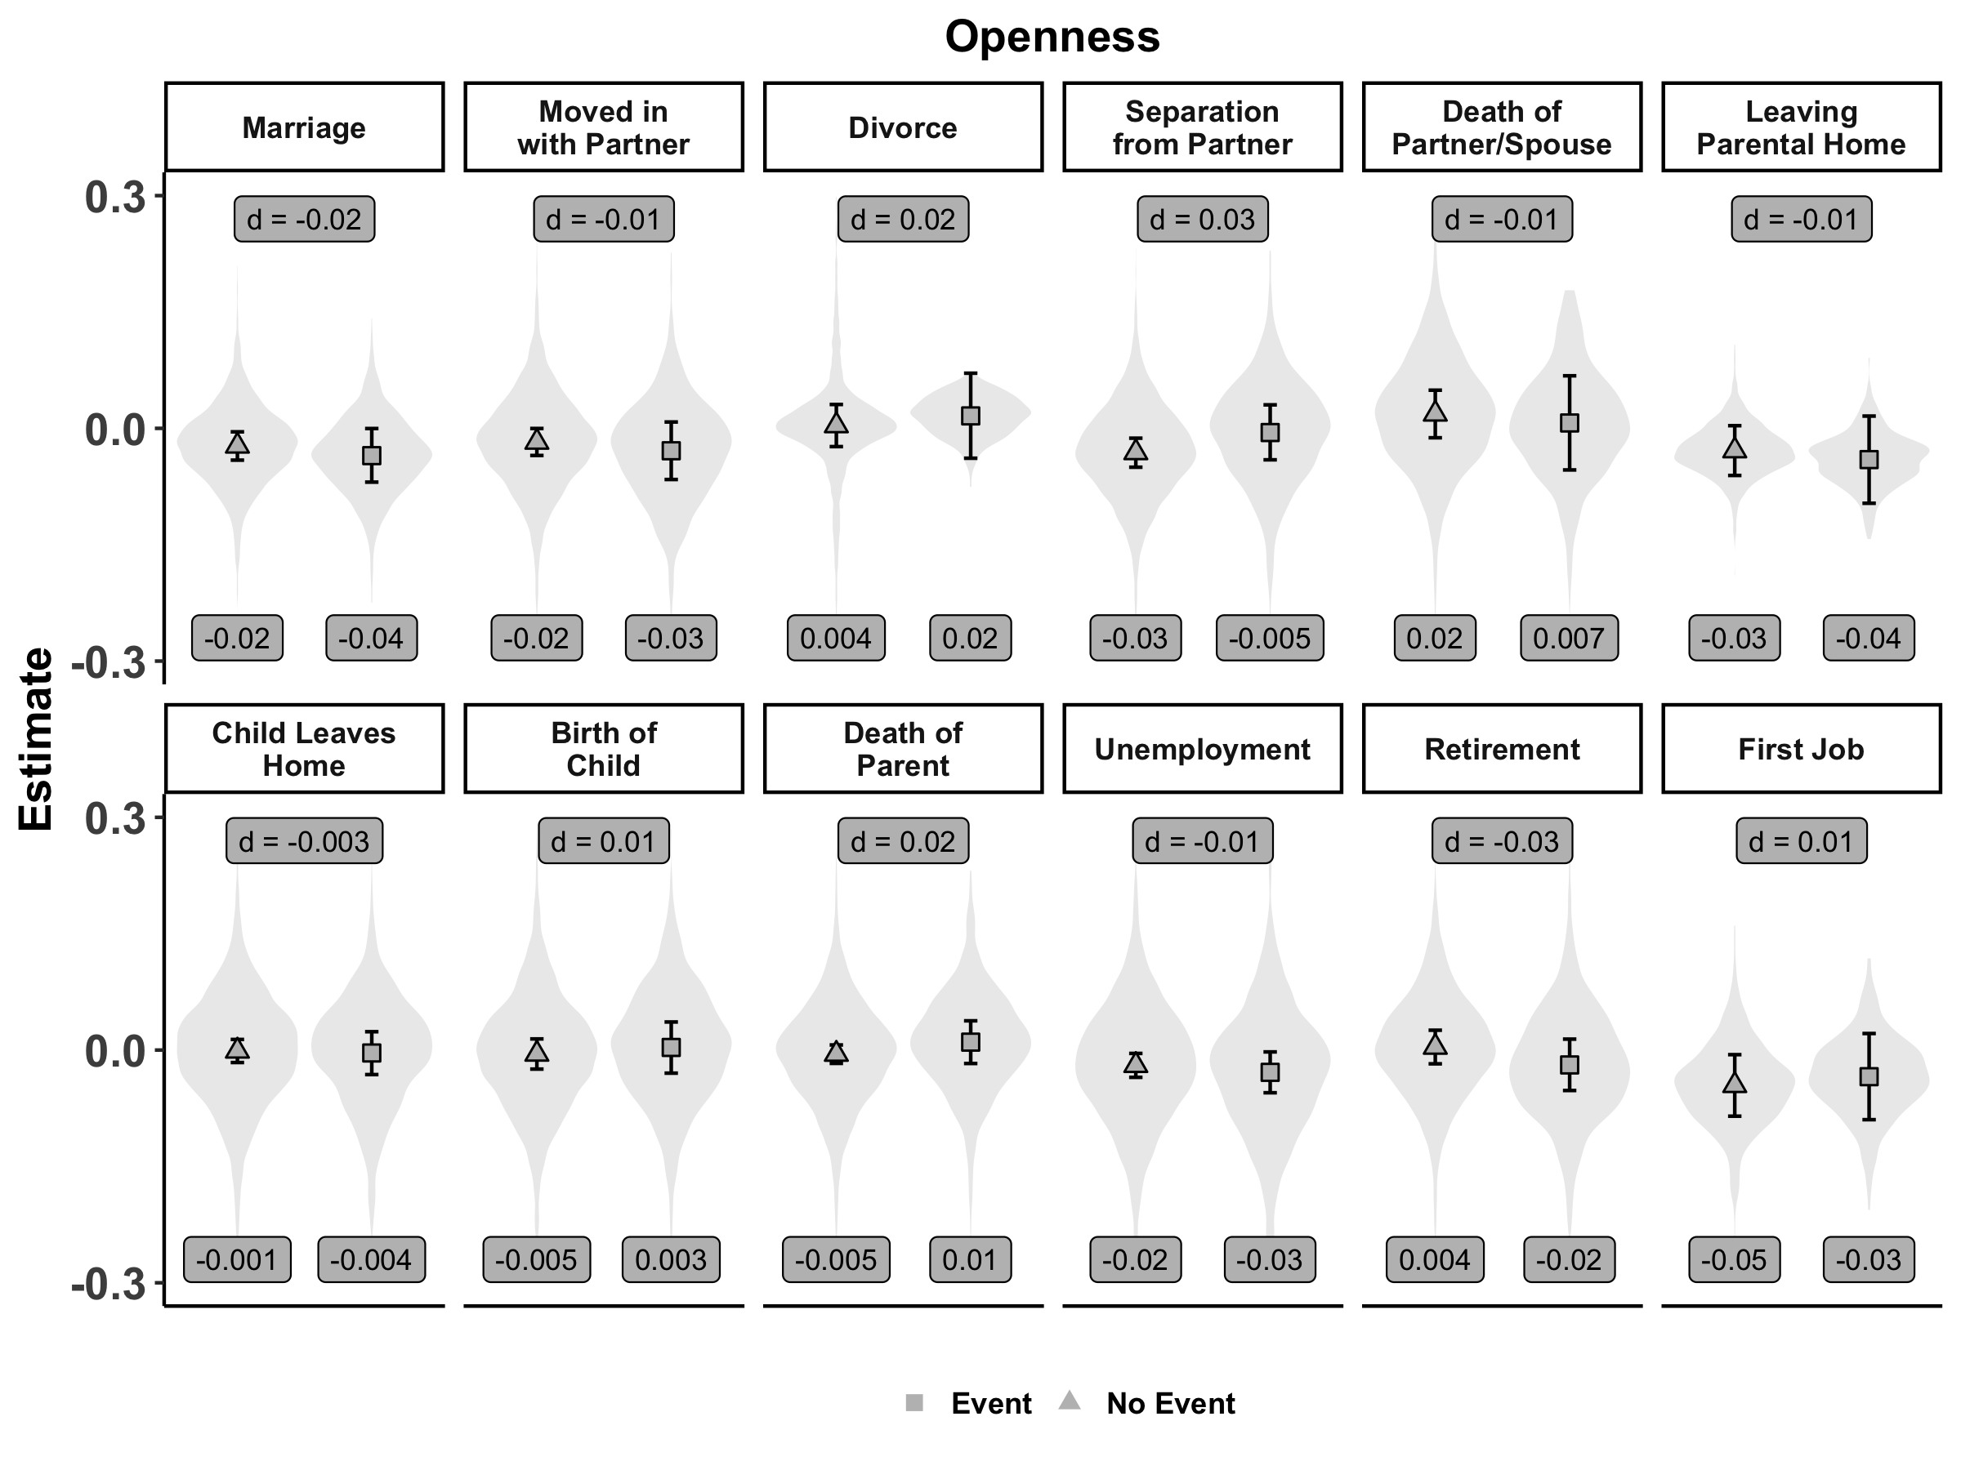
Selection | Socialization | Individual Differences

Slide 60
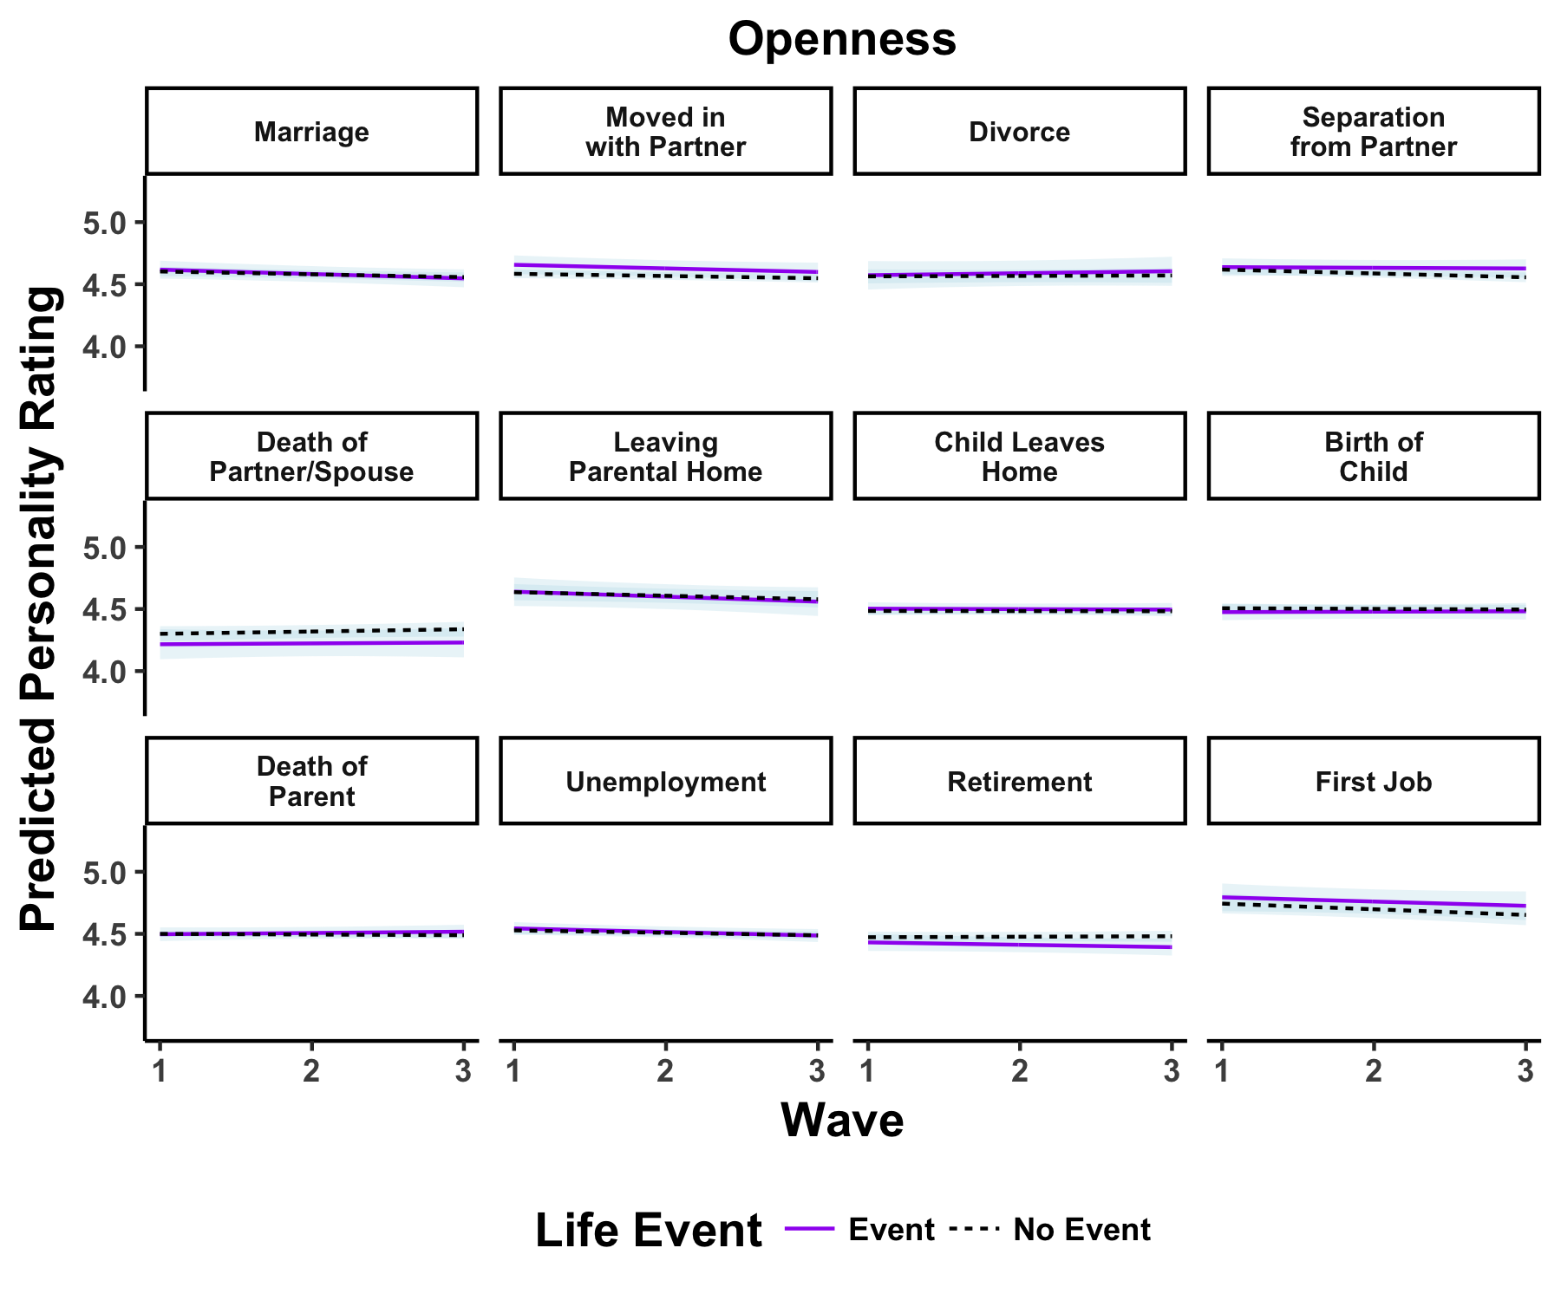
Selection | Socialization | Individual Differences

Slide 61
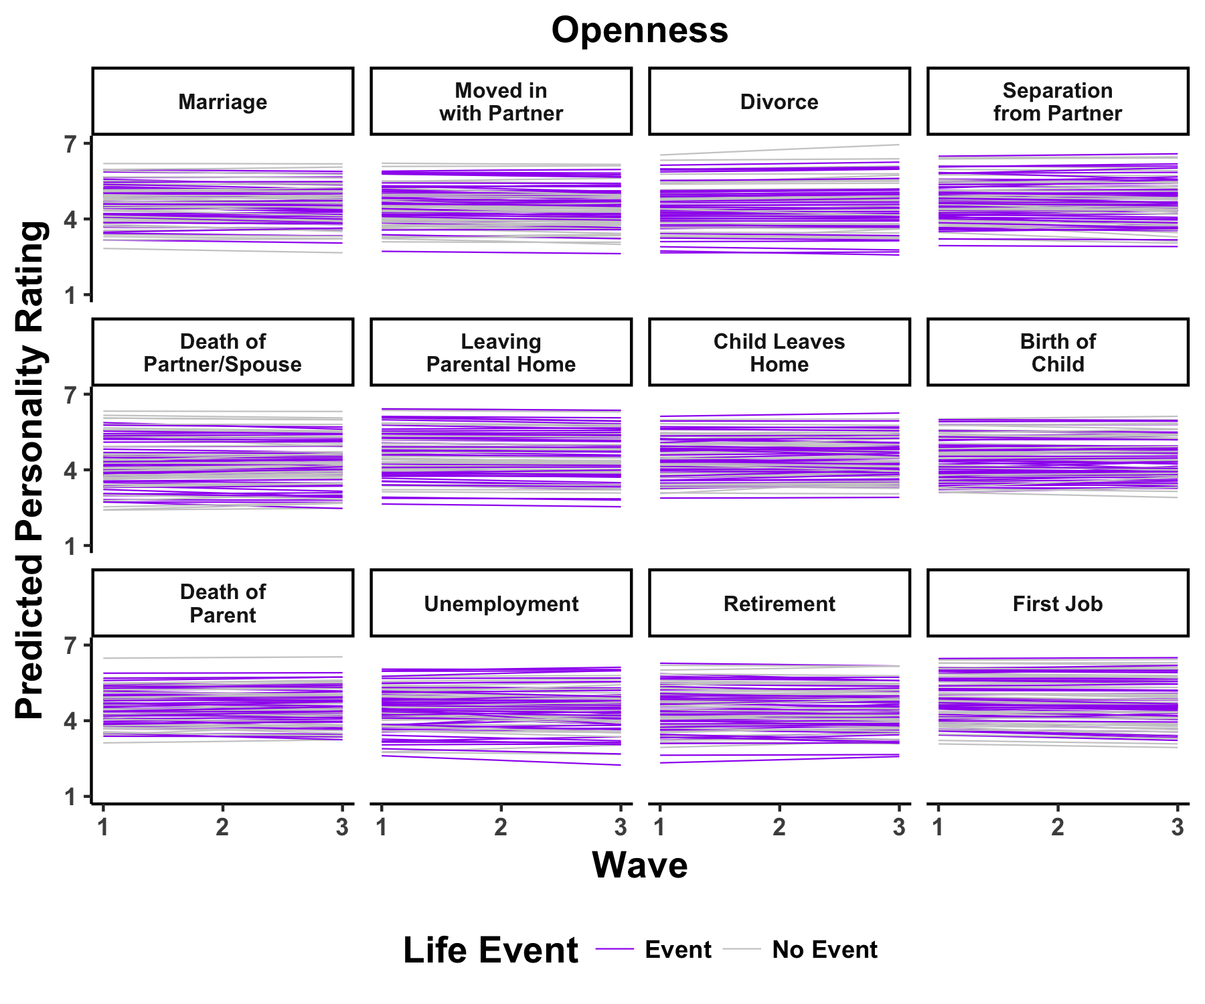
Selection | Socialization | Individual Differences

Slide 62
>
Selection
Socialization
E
A
C
N
O
E
A
C
N
O
Life Events
Life Events
Notes:
PAUSE HERE AND BE LIKE THIS IS COOL. IMMA LET THIS SINK IN

Slide 63
Selection | Socialization | Individual Differences
Selection
E
A
C
N
O
Mechanisms
Over-Controlling
Life Events

Slide 64
Selection | Socialization | Individual Differences
Selection
E
A
C
N
O
Background Characteristics
Life Events

Slide 65
Selection | Socialization | Individual Differences
Selection
Income
Social
Early Life
Affect
Satisfaction
E
A
C
N
O
Age
Health
Gender
Education
Family
Background Characteristics
Life Events

Slide 66
Selection | Socialization | Individual Differences
Selection
No Event
Event
Conscientiousness
Work Experiences
18
40
Barrick, Mount, & Judge, 2001
Notes:
overcontrolling

Slide 67
Selection | Socialization | Individual Differences
Selection
Income
Conscientiousness
Healthcare
Education
Health Behaviors
Health
Hampson, Goldberg, Vogt, & Dubanoski, 2007
Notes:
Overcontrolling – these are some of the mechanisms through which conscientiousness infliuences health. SO what is helath when these are controlled for

Slide 68
Selection | Socialization | Individual Differences
Socialization
Non-Linearity
E
A
C
N
O
Event Time
Individual Differences in Change
Life Events

Slide 69
Selection | Socialization | Individual Differences
Personality
1984
2005
2009
2013
Life Events

Slide 70
Selection | Socialization | Individual Differences
Schwaba & Bleidorn, 2017; Doss et al., 2009 ; Bleidorn et al., 2016

Slide 71
Selection | Socialization | Individual Differences
Openness, Agreeableness
Retirement
Schwaba & Bleidorn, 2017; Doss et al., 2009 ; Bleidorn et al., 2016

Slide 72
Selection | Socialization | Individual Differences
Event Time

Slide 73
Selection | Socialization | Individual Differences
Close to Transition
“Tipping Points”
chronic
Loss of Functioning
recovery
delayed
Far from Transition
resilience
Time
Bonanno, 2004; van Leemput et al., 2014; Cramer et al., 2016; Cabrieto et al., 2018
Notes:
Also evidence that the point of change differs across people
So how do we identify tipping points?

Slide 74
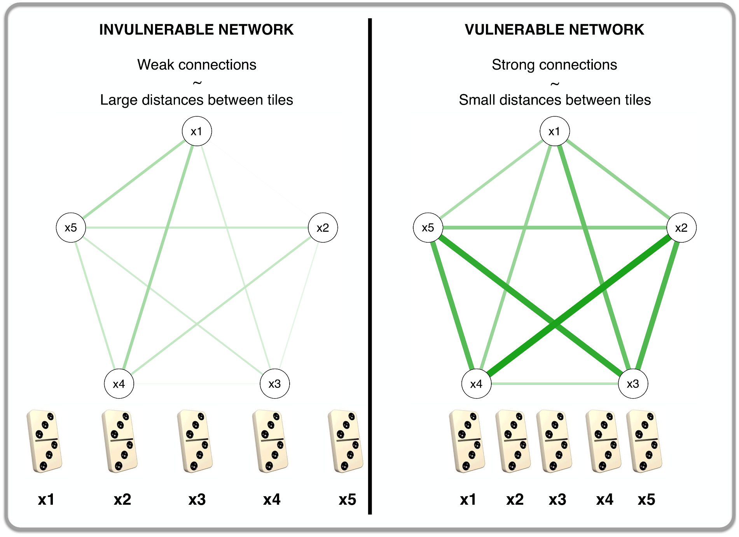
Selection | Socialization | Individual Differences
Close to Transition
“Tipping Points”
Far from Transition
Bonanno, 2004; van Leemput et al., 2014; Cramer et al., 2016; Cabrieto et al., 2018
Notes:
Also evidence that the point of change differs across people
So how do we identify tipping points?

Slide 75
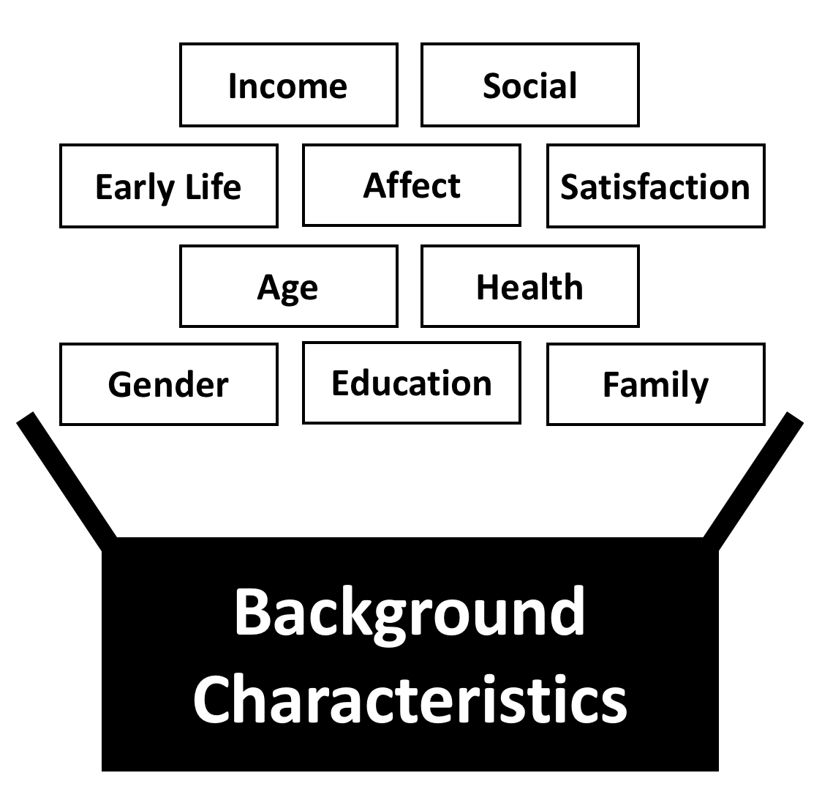
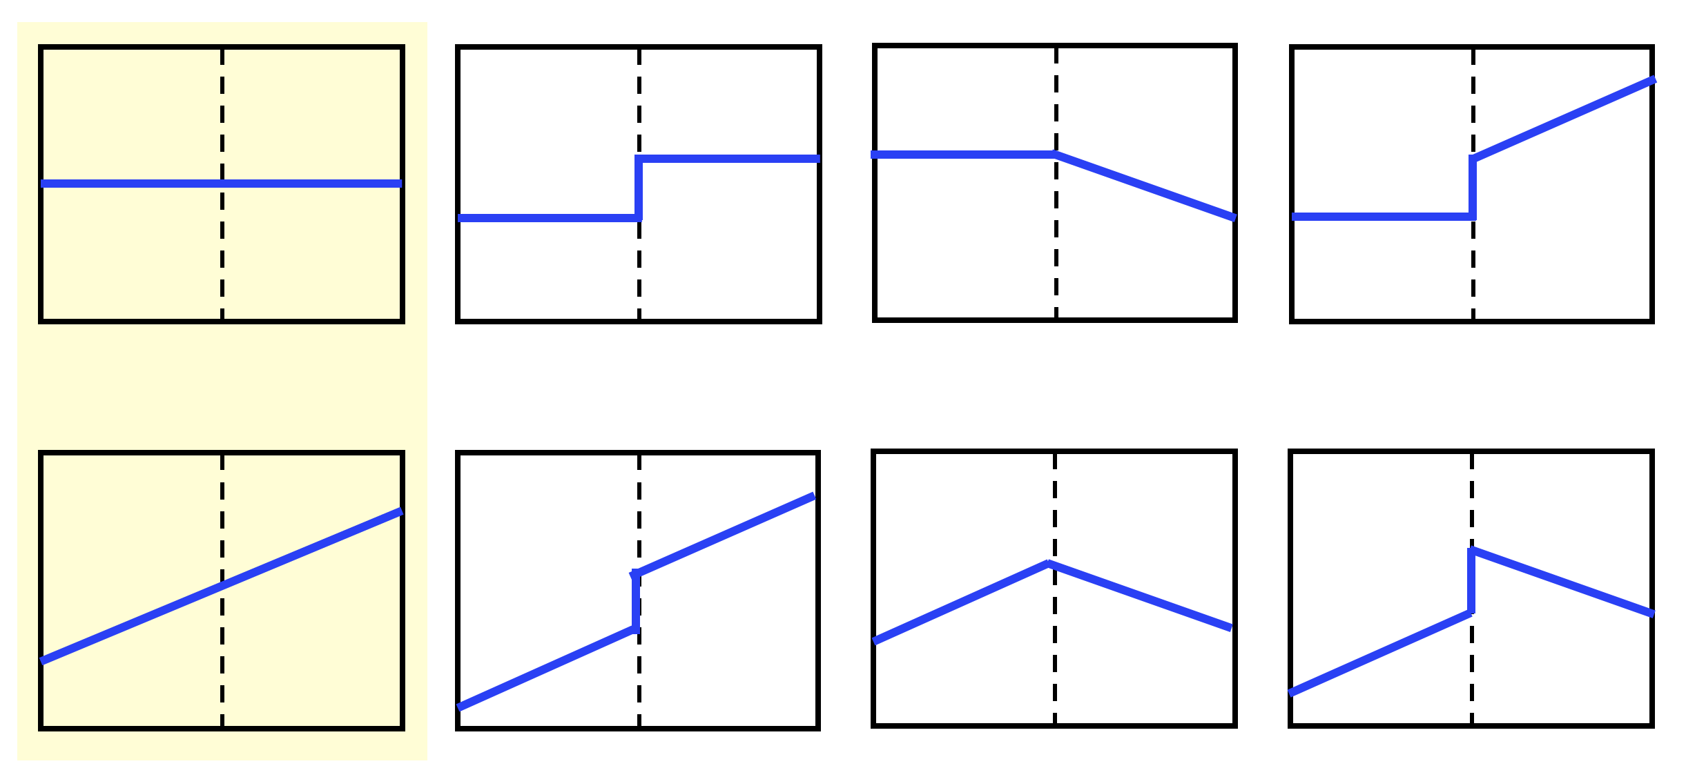
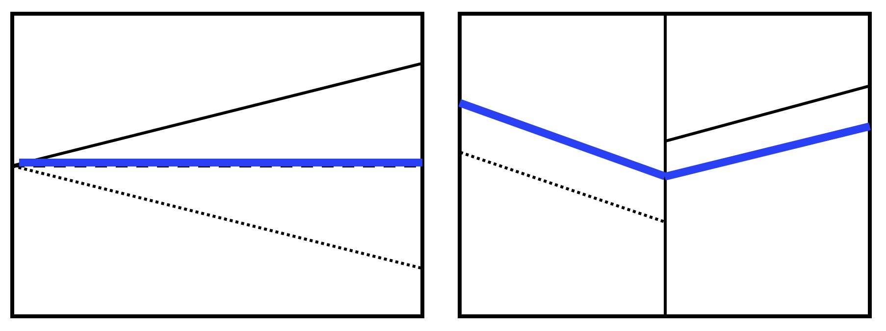
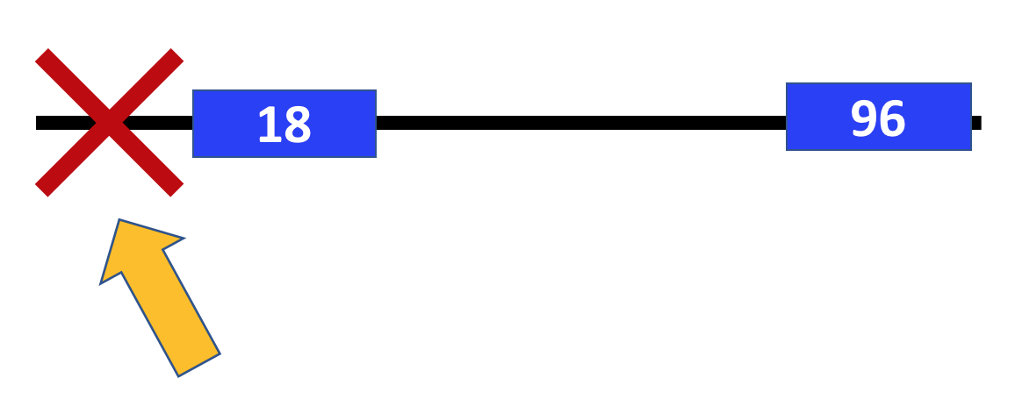
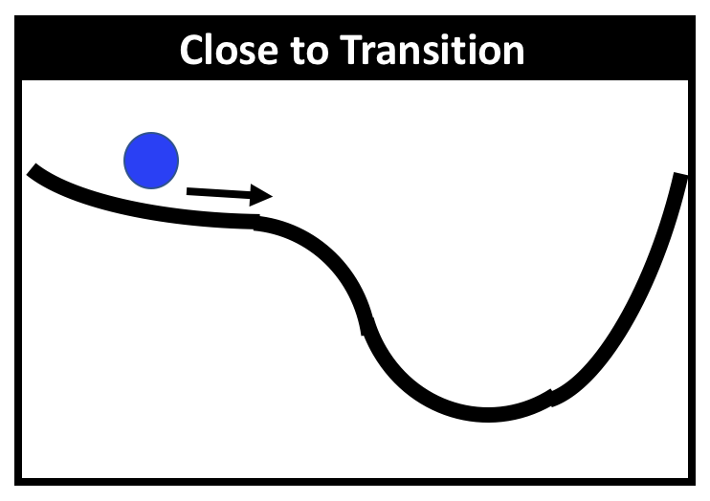
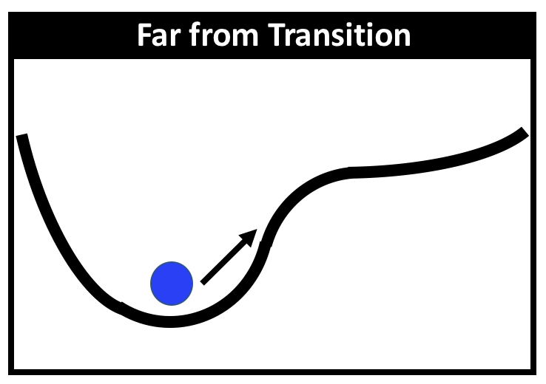
>
Selection
Socialization
Mechanisms
Non-linearity
Event Timing
Identifying Tipping Points
Over-Controlling

Slide 76
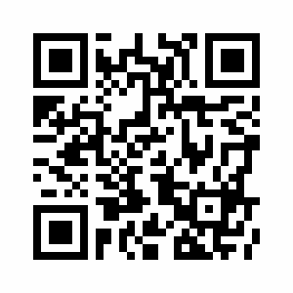
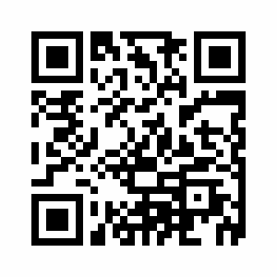
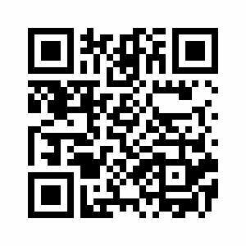
Questions?
Special Thanks to:
Josh Jackson
The PMaD Lab
Pat Hill
Tom Oltmanns
Results:
emoriebeck.github.io/life_events
Data and Code:
github.com/emoriebeck/life_events
osf.io/hy4da
Shiny App:
emoriebeck.shinyapps.io/life_events

Slide 77
TESSERA Framework
*T*riggering Situations
*E*xpectancies
*S*tates / *S*tate *E*xpressions
*R*e*A*ctions

Slide 78
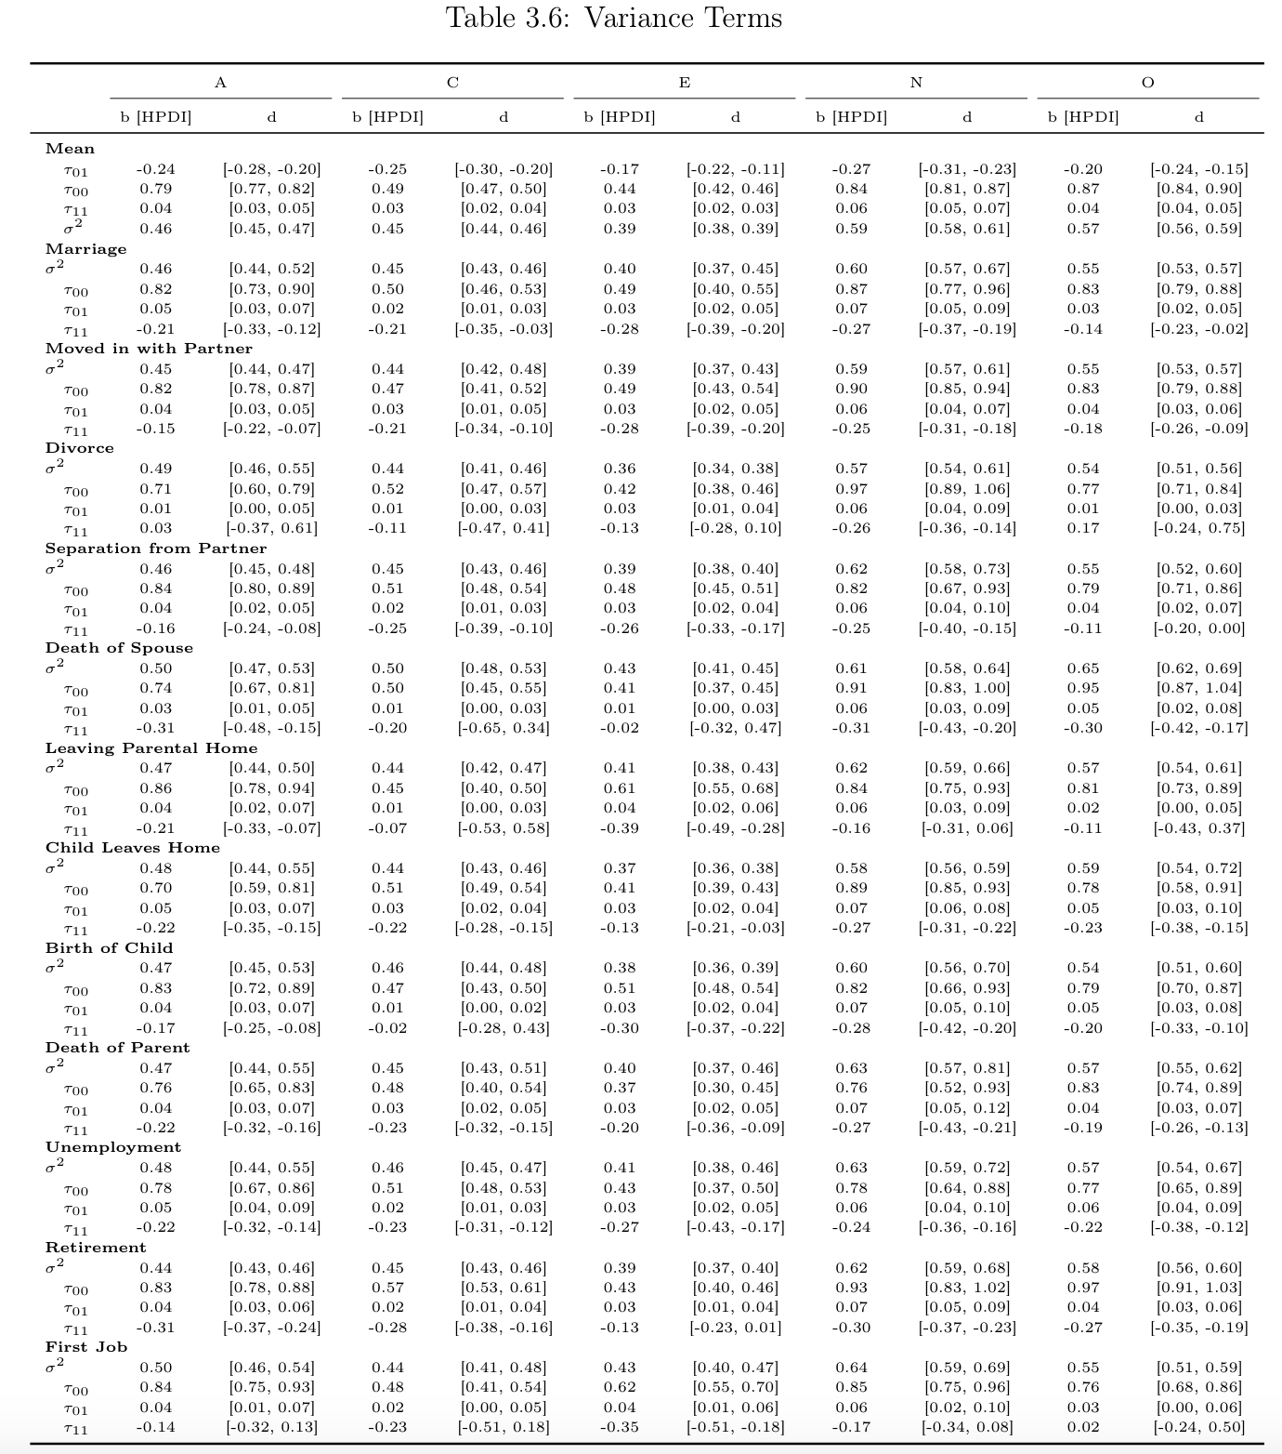
Level 2 Variances

Slide 79
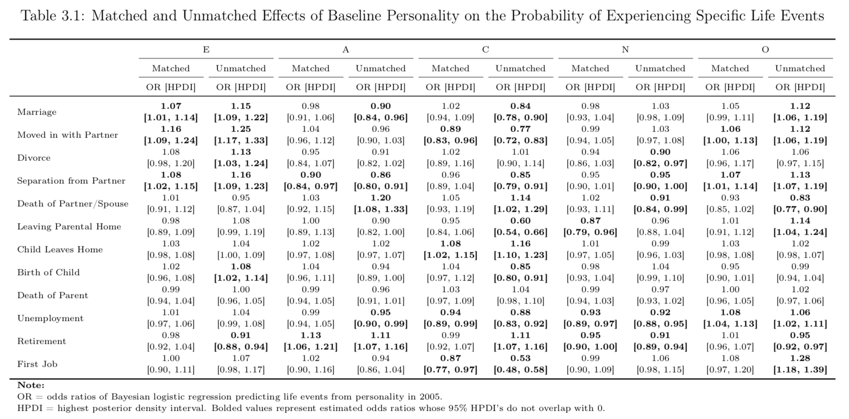

Slide 80
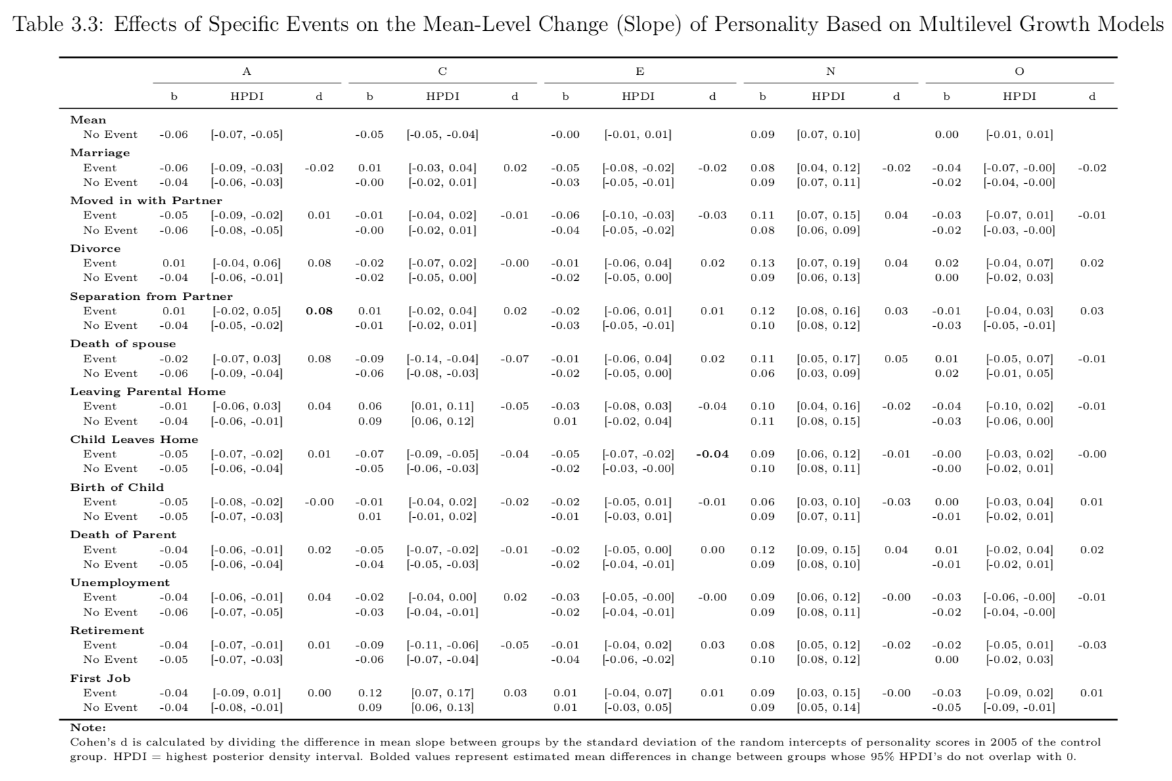

Slide 81
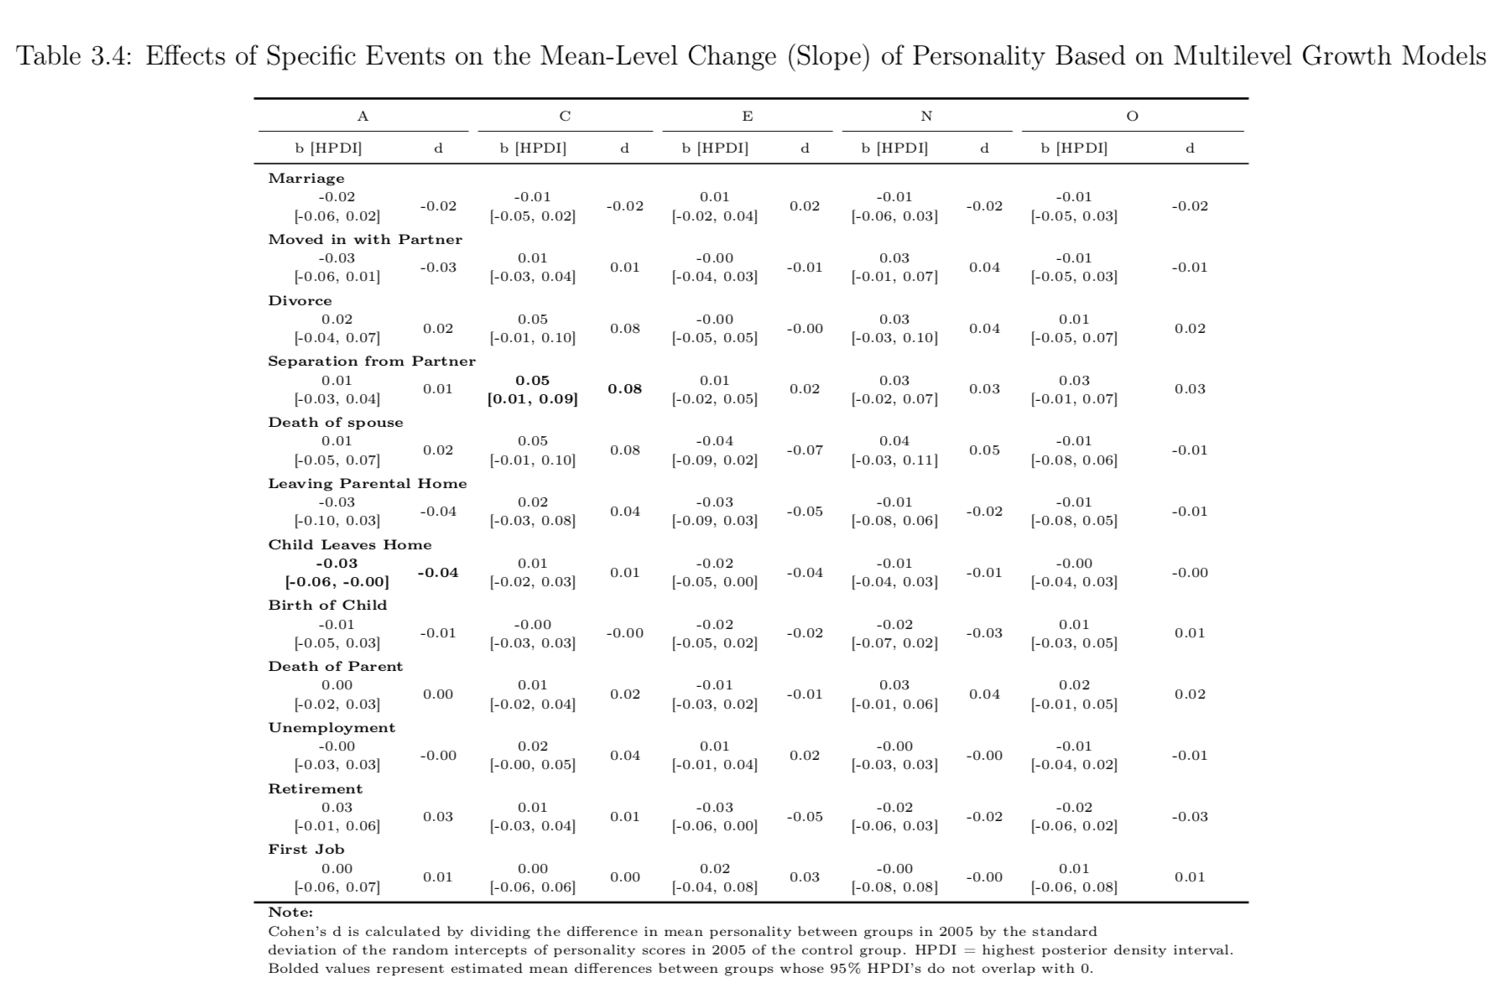

Slide 82
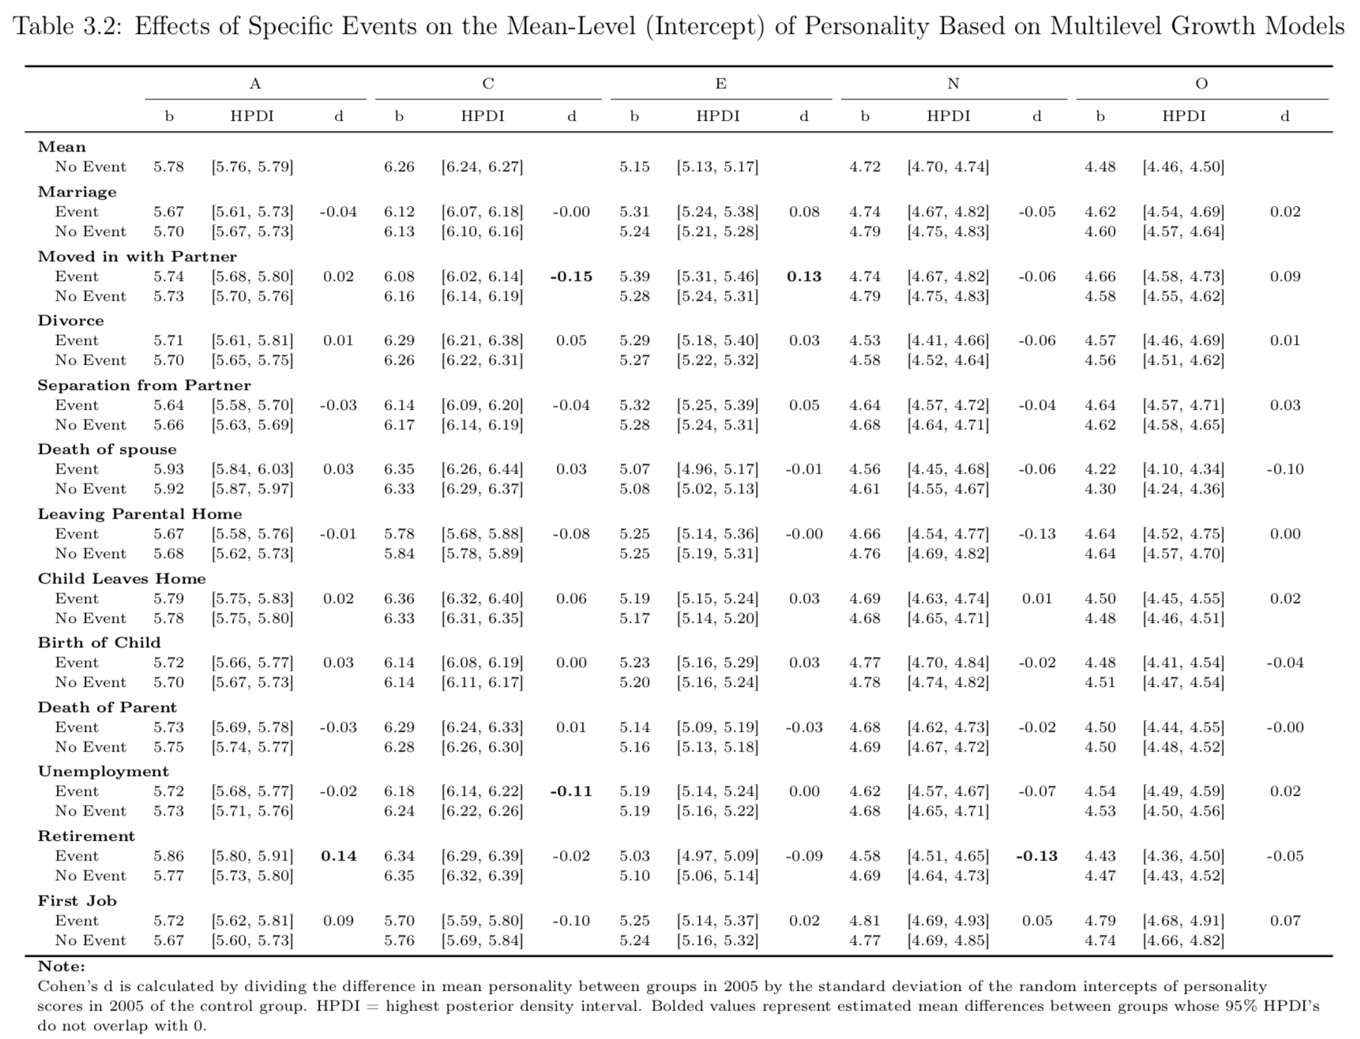

Slide 83


